Slide 1
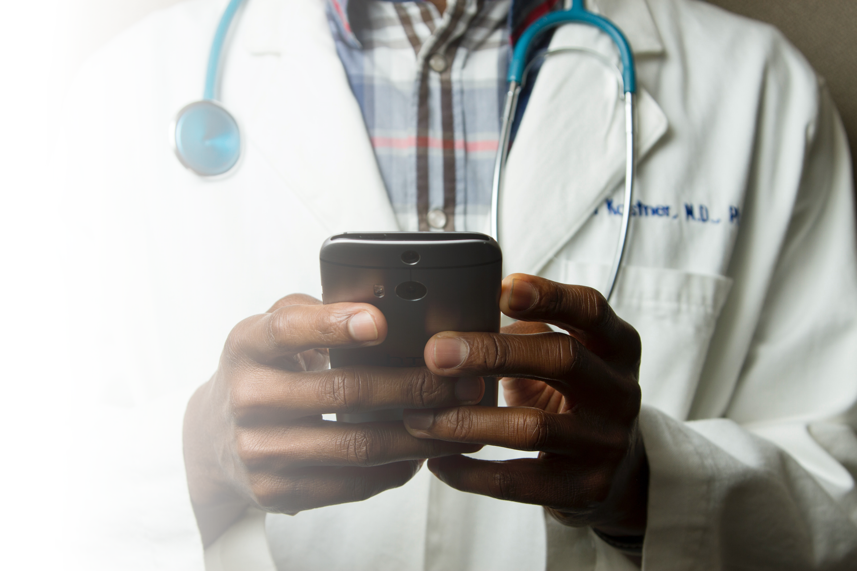
NCTRC Telehealth Hack Series
Building Accessible Telehealth for Patients with Disabilities from the Ground Up
October 26th, 2020

Slide 2
NCTRC Telehealth Hack Data
The National Consortium of Telehealth Resource Centers collects registration, participation, questions/answers, chat comments, and poll responses for this program and shares this data with the HHS – Health Resources and Services Administration (HRSA). Your individual data will be kept confidential. These data may be used for reports, maps, communications, surveys, quality assurance, evaluation, research, and to inform new initiatives

Slide 4
Transitioning from HHS - ASPR
The National Consortium of Telehealth Resource Centers (NCTRC) have played an active role throughout the legacy HHS – ASPR Telemedicine Hack series. With the program becoming widely popular, HHS – ASPR has agreed to transition the program to the NCTRC.
With the Telehealth Hack program now fully transitioned, the NCTRC will provide peer-to-peer learning sessions through March 2021, covering core topics and specialties where telehealth is utilized.

Slide 5
Webinar Tips and Notes
Your phone &/or computer microphone has been muted.
Please place your questions into the Q&A function.
For technical assistance with Zoom, please use the Chat function.
Attendees are able to adjust video sizing via Zoom’s sliding feature.
Attendees can toggle Closed Captioning in the toolbar.
The webinar is being recorded.
Recordings will be posted to our website and YouTube Channel:
www.telehealthresourcecenter.org
https://www.youtube.com/c/nctrc

Slide 6
UAMS Disclosure Policy
It is the policy of the University of Arkansas for Medical Sciences (UAMS) to ensure balance, independence, objectivity, and scientific rigor in all directly or jointly provided educational activities.
All individuals who are in a position to control the content of the educational activity (course/activity directors, planning committee members, staff, teachers, or authors of CE) must disclose all relevant financial relationships they have with any commercial interest(s) as well as the nature of the relationship. Financial relationships of the individual’s spouse or partner must also be disclosed, if the nature of the relationship could influence the objectivity of the individual in a position to control the content of the CE. The ACCME and ACPE describe relevant financial relationships as those in any amount occurring within the past 12 months that create a conflict of interest. Individuals who refuse to disclose will be disqualified from participation in the development, management, presentation, or evaluation of the CE activity.

Slide 7
Disclosures
The following planners and speakers of this CE telehealth series and activities have no relevant financial relationships with commercial interests to disclose:
Ray Dizon
Mei Kwong, JD
Kathy Wibberly, PhD
Doris Barta, MHA
Nichole Perisho
Becky Bounds
Jordan Berg
Alysa Bass, JD
Clarette Yen, JD
Jason Jent, PhD
Michael McKee, MD
The accreditation compliance reviewer, Courtney Bryant, has no financial relationships with commercial interests to disclose.

Slide 8
Joint Accreditation and Credit Designation Statements
Joint Accreditation Statement
In support of improving patient care, this activity has been planned and implemented by the University of Arkansas for Medical Sciences and National Consortium on Telehealth Research Centers. University of Arkansas for Medical Sciences is jointly accredited by the Accreditation Council for Continuing Medical Education (ACCME), the Accreditation Council for Pharmacy Education (ACPE), and the American Nurses Credentialing Center (ANCC) to provide continuing education for the healthcare team.
AMA Credit Designation Statement
The University of Arkansas for Medical Sciences designates this live activity for a maximum of 1.0 AMA PRA Category 1 CreditsTM. Physicians should claim only the credit commensurate with the extent of their participation in the activity.
ACPE Credit Designation Statement
These knowledge based activities will provide pharmacists up to 1.0 contact hours or 0.1 CEU. CE credit information, based on verification of live attendance and completion of the program evaluation, will be provided to NABP within 60 days after the activity completion.

Slide 9
Joint Accreditation and Credit Designation Statements
Joint Accreditation Statement
In support of improving patient care, this activity has been planned and implemented by the University of Arkansas for Medical Sciences and National Consortium on Telehealth Research Centers. University of Arkansas for Medical Sciences is jointly accredited by the Accreditation Council for Continuing Medical Education (ACCME), the Accreditation Council for Pharmacy Education (ACPE), and the American Nurses Credentialing Center (ANCC) to provide continuing education for the healthcare team.
ANCC Credit Designation Statement
The University of Arkansas for Medical Sciences designates this live activity for a maximum of 1.0 ANCC contact hours. Nursing contact hours will be awarded for successful completion of program components based upon documented attendance and completion of evaluation materials.
AAPA Credit Designation Statement
The University of Arkansas for Medical Sciences has been authorized by the American Academy of PAs (AAPA) to award AAPA Category 1 CME credit for activities planned in accordance with AAPA CME Criteria. This activity is designated for 1.0 AAPA Category 1 CME credits. PAs should only claim credit commensurate with the extent of their participation.

Slide 10
Deadline!!!
All evaluations must be completed by
Wednesday, October 28, 2020
If you do not complete an evaluation by this deadline, you will not receive continuing education hours for this conference.

Slide 11
Access Code
In order to access the evaluation on LOD, you must enter the access code.
NCTRC2020

Slide 12
Course Evaluation & CE Certificate
Deadline is October 28, 2020
Access Code is NCTRC2020
www.learnondemand.org
Questions about evaluations and/or certificates should be directed to IDHIeducation@uams.edu
or 1-855-234-3348

Slide 13
Today’s Agenda
Case Study #1: Increasing Reach and Accessibility of Telehealth Services for Children with Disabilities during COVID-19 and Beyond (10 min)
Q&A Follow-up (5 min) – Moderated by Dr. Christian Ramers.
Didactic: Federal Legal Considerations for Accessible Telehealth for Individuals With Disabilities (16 min)
Q&A Follow-up (5 min) – Moderated by Dr. Christian Ramers.
Case Study #2: Increasing Reach and Accessibility of Telehealth Services for Children with Disabilities during COVID-19 and Beyond (12 min)
Closing Remarks – Mei Kwong, JD (5 min)

Slide 14
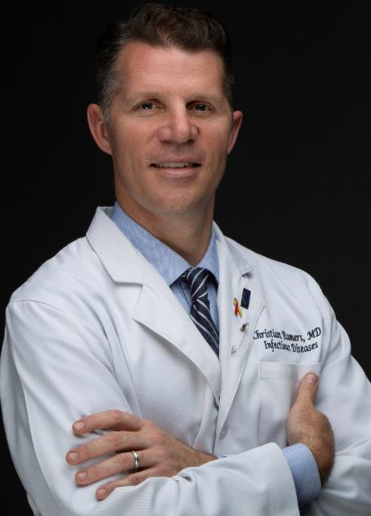
Facilitator Introduction
Christian B. Ramers, MD, MPH, AAHIVS – Biosketch
Dr. Ramers is the Chief of Population Health and Director of Graduate Medical Education at the Family Health Centers of San Diego (FHCSD), a large Federally Qualified Health Center (FQHC) system serving nearly 200,000 medically underserved individuals throughout San Diego county. He is board certified in Internal Medicine, Infectious Diseases, and Addiction Medicine, and is particularly interested in HIV, HBV, HCV, and service of medically underserved, immigrant, and refugee populations. He co-chairs the California Chapter of the American Academy of HIV Medicine and has advocated for HIV/HCV care at the state legislative level. He has served as a consultant for CDC-sponsored HIV/HBV/HCV educational projects in Asia and Africa. Since 2018 he has served as the Senior Clinical Advisor for the Clinton Health Access Initiative’s Global Hepatitis Program, working to eliminate HBV and HCV in seven partner countries in Asia and Africa.

Slide 15
Case Study #1
Topic: Increasing Reach and Accessibility of Telehealth Services for Children with Disabilities during COVID-19 and Beyond
Jason Jent, PhD - The University of Miami Miller School of Medicine, Mailman Center for Child Development

Slide 16
Increasing Reach and Accessibility of Telehealth Services for Children with Disabilities during COVID-19 and Beyond
Jason Jent, PhD
Associate Professor of Clinical Pediatrics
Mailman Center for Child Development
Miller School of Medicine
University of Miami

Slide 17
About the Mailman Center for Child Development
Serve over 15,000 children per year
Emphasis on serving families of children with developmental disabilities and/or special healthcare needs
Education, prevention, screening, assessment, and intervention

Slide 18
Mailman Clinical Services- Pre-COVID-19
Exclusively In-Person
Developmental and Behavioral Pediatrics
Assistive Services and Technology Use
Audiology and Hearing Loss
Speech and Language
Psychoeducational Evaluations
Hybrid (Telehealth & In-Person
Pediatric Psychology
Parenting
School-Based Primary Care

Slide 19
Transitioning to Telehealth During Stay-at-Home Order
72 hour transition period
Internal Telehealth capacity building
Session/Appointment simulation with experienced providers
Telehealth Community of Practice
Telehealth guides

Slide 20
Telehealth Accessibility and Service Delivery
Shift from provider-child interactions to caregiver-mediated interactions
Coaching and child observations
Caregiver completes similar tasks with child as provider would in person
Referrals for some programs increased during stay-at-home because service provision continued

Slide 21
Telehealth Mailman Center Highlights
Assistive Technology (AT) Program
Traditionally offered via in-person training and lending of low tech and high tech AT devices to children with disabilities
Families using AT devices now receive demonstrations and training via telehealth
Notes:
Children and adults
Evaluations and training via telehealth
When lending out devices to parents and providers, we’ve created accessible PDF demonstration guides and videos that demonstrate how to use the device. We also schedule a follow-up zoom meeting to provide any technical assistance related to using the device. In this way we are providing synchronous and asynchronous support to families and providers.
We’ve started conducting AAC evaluations remotely. We send pre-programmed device(s) ahead of time and also send an iPad and tripod. Prior to the evaluation we schedule a video conference meeting to demonstrate how to use the device and set up the iPad and tripod for recording the zoom session. During the zoom session the caregiver is coached to implement the activities and use the device(s) with the child or individual. We implement the same system when trialling the Augmentative and Alternative Communication device during the trial period. We have also started offering a hybrid approach where we conduct the interview remotely and then we bring the child or individual in to meet with the clinician for the actual AAC evaluation. During this time, to minimize the number of people in the room, all other team members (trainees, AT specialist, OT) zoom in and we use bug-in-the ear technology to communicate with the SLP who is conducting the evaluation. We record the session and use the chat box to make observations that help us when writing the report and providing feedback to the family.

Slide 22
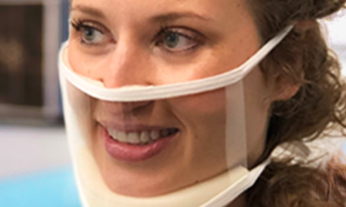
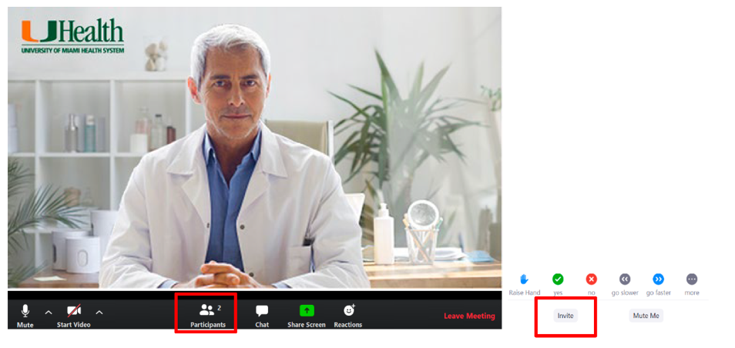
Telehealth Interpreter Services
Clear Communicator Masks for providers on-site
Video Remote Interpreting

Slide 23
Telehealth Written Materials
Send PDFs of written materials in advance of appointment/workshop
Avoid use of text boxes in slide presentations
Inquire about screen size and zoom in as needed
Closed captioning within any multimedia and hyperlinks to videos
Alternative text for images

Slide 24
Movement Toward Increased Accessibility of Telehealth Services
Children with disabilities at highest risk for further disparities during COVID-19
Additional telehealth accessibility training being provided
Tablet equipment and hot spot loan service
Integration of AT device software available on computers and tablets for telehealth services.
Notes:
Intersectionality between children with disabilities and socioeconomic status

Slide 25
Thank you for your attention!
Questions?

Slide 26
Didactic
Topic: Federal Legal Considerations for Accessible Telehealth for Individuals With Disabilities
Alyse Bass, JD - U.S. Department of Justice, Civil Rights Division, Disability Rights Section
Clarette Yen, JD - U.S. Department of Justice, Civil Rights Division, Disability Rights Section

Slide 27
Accessibility in Telehealth
Disability Rights Section Civil Rights Division
U.S. Department of Justice
October 22, 2020

Slide 28
Learning Objectives
Enable you to understand health care providers and organizations’ obligations under the Americans with Disabilities Act (ADA) and Section 504.
Understand that legal obligations apply regardless of whether services are provided in person or virtually.

Slide 29
Legal Background

Slide 30
What Laws Apply?
The Americans with Disabilities Act (ADA) and Section 504 of the Rehabilitation Act (Section 504) are Federal civil rights laws that prohibit discrimination against people with disabilities.

Slide 31
What Laws Apply?
Both Section 504 and the ADA state that no qualified individual with a disability shall, by reason of his or her disability, be excluded from the participation in, denied the benefits of, or subjected to discrimination under any services, programs, or activities of the covered entity.

Slide 32
Nondiscrimination
In the context of healthcare, nondiscrimination on the basis of disability means equal access to available health care services, whether those services are provided in-person or through a virtual platform such as a telemedicine appointment.

Slide 33
Definition of Disability
a physical or mental impairment that substantially limits one or more major life activities or major bodily functions;
a record (or past history) of such an impairment; or
being regarded as having a disability.
The definition of “disability” should be interpreted
broadly.

Slide 34
Covered Entity
What is a covered entity?
ADA Title II: State or local government
ADA Title III: Public accommodation or commercial facility

Slide 35
What Laws Apply?
Title II of the ADA covers all activities of state & local governments (termed: public entities) regardless of the receipt of federal funding, including healthcare.
Title III of the ADA covers twelve categories of places of public accommodation, including professional offices of health care providers, hospitals, social service center establishments, insurance offices, and pharmacies.

Slide 36
What Laws Apply?
Section 504 applies to:
Programs and activities conducted by Federal agencies, and
Entities receiving any Federal financial assistance (which can include Medicare and Medicaid reimbursements).

Slide 37
What Do These Laws
Require in this Context?
Covered entities must ensure that communication with people with disabilities is as effective as communication with others.

Slide 38
What is effective
communication?

Slide 39
Effective Communication
Effective communication must be provided to the person with a disability who is receiving the covered entity’s goods or services as well as with that person’s parent, spouse, or companion with a disability in appropriate circumstances.

Slide 40
Effective Communication
Covered entities must provide auxiliary aids and services to ensure effective communication with people who have hearing, vision, or speech disabilities.

Slide 41
How prevalent are disabilities that
require an auxiliary aid or service?
13 percent, or 30 million people ages 12 or
older have hearing loss in both ears, based on standard hearing examinations.
Approximately 7.5 million people in the United States have trouble using their voices.
7.3 million individuals in the United States report significant vision loss.

Slide 42
Effective Communication: Limitations
A covered entity need not take any action to ensure
effective communication if it can demonstrate that
doing so would fundamentally alter the nature of the service, program, or activity.
Not required to take actions that would result in
undue financial and administrative burdens.
Shall take any other action that would nevertheless
ensure that, to the maximum extent possible,
individuals with disabilities receive the benefits or services provided by the covered entity.

Slide 43
What are auxiliary aids and services, and what are the requirements for
them?

Slide 44
Auxiliary aids and services
Examples of auxiliary aids and services for people who are deaf or have hearing loss:
Qualified sign language interpreter
Qualified cued-speech interpreter
Qualified tactile interpreter
Real-time captioning (CART)
Video remote interpreting (VRI)
Written materials

Slide 45
Qualified Interpreter
Qualified interpreter means an interpreter who, via VRI service or an on-site appearance, is able to interpret:
effectively, accurately, and impartially
both receptively and expressively
using any necessary specialized vocabulary

Slide 46
Video Remote Interpreting (VRI)
If VRI is chosen, all of the following specific performance standards must be met:
Real-time, full-motion video and audio over a dedicated high-speed, wide-bandwidth video connection or wireless connection that delivers high-quality video images that do not produce lags, choppy, blurry, or grainy images, or irregular pauses in communication;

Slide 47
Video Remote Interpreting (VRI)
A sharply delineated image that is large enough to display the interpreter’s face, arms, hands, and fingers, and the face, arms, hands, and fingers of the person using sign language, regardless of his or her body position;
A clear, audible transmission of voices; and
Adequate staff training to ensure quick set-up and proper operation.

Slide 48
Auxiliary aids and services
Examples of auxiliary aids and services for people who are blind or have vision loss:
A qualified reader
Information in large print, Braille, or electronically for use with a computer screen-reading program
An audio recording of printed information

Slide 49
Auxiliary aids and services
Examples of auxiliary aids and services for people who have speech disabilities:
Providing a qualified speech-to-speech transliterator (a person trained to recognize unclear speech and repeat it clearly)
Paper or pencil for written note exchange

Slide 50
Effective Communication
Covered entities must furnish appropriate auxiliary aids and services where necessary for effective communication at no charge.

Slide 51
How do you provide effective
communication?

Slide 52
Effective Communication
Type of appropriate auxiliary aid or service necessary will vary based on:
Method of communication used by the individual
Nature, length, and complexity of communication involved
Context in which communication is taking place

Slide 53
Effective Communication
Must provide auxiliary aids and services:
In a timely manner
In a manner that protects the privacy and independence of the individual

Slide 54
Effective Communication
May not require individuals to bring their own interpreter
May not require adults accompanying individual to interpret except:
In an emergency where no interpreter is available, or
Where specifically requested by the individual with a disability, the accompanying adult agrees, and it is appropriate under the circumstances

Slide 55
Effective Communication
In the context of telemedicine, a provider who takes appropriate steps to furnish individuals with disabilities auxiliary aids and services when scheduling or holding virtual telemedicine appointments, helps to ensure that its patients are afforded effective communication.

Slide 56
Telemedicine
Hospitals or health care providers that offer virtual medical appointments through a telemedicine platform that has the capacity to enable them to bring in a third party–-for example an ASL interpreter for an individual who is deaf–-better ensure that patients with disabilities are afforded equal access to virtual medical appointments.

Slide 57
Hacks for Accessible Telemedicine
As you invest in permanent changes to include telemedicine in your practice, consider using a telemedicine platform that has capacity to add a third party, for example an interpreter for someone who is deaf, or a remote care provider for a patient with an intellectual disability.
Consider reasonably modifying your pre-telemedicine appointment practices to allow for additional time to provide a patient with a visual or intellectual disability extra assistance with using the video platform technology.

Slide 58
ADA.GOV
Recent Settlements on Interpreters Tufts Medical Center (Massachusetts 2020) Lincare, Inc. (Virginia, 2019)
Carilion Roanoke Memorial Hospital (Virginia, 2019)
Washington State Health Care Authority (Washington, 2018)
Astria Health (Washington, 2018)
Seminole Neurology Associates (Florida, 2017)

Slide 59
ADA.GOV
Recent Settlements on Equal Access to Health Care Services
Massachusetts General Hospital (Massachusetts 2020)
Thomas Jefferson University Hospital (Pennsylvania 2019)
Charlotte Radiology (August 2018)

Slide 60
Who to contact if you
have questions?

Slide 61
Resources
www.ADA.gov
ADA Information Line
1-800-514-0301 (voice) or 1-800-514-0383 (TTY)

Slide 62
Contacts
Alyse Bass, Trial Attorney Alyse.Bass@usdoj.gov
Clarette Yen, Attorney Advisor Clarette.Yen@usdoj.gov
Disability Rights Section
Civil Rights Division Department of Justice

Slide 63
Case Study #2 (Pre-recorded Presentation)
Topic: COVID-19’s Impact on Deaf and Hard of Hearing Patients- Identify the Barriers and Solutions to Address Them
Michael McKee, MD, MPH - The University of Michigan/Michigan Medicine, Department of Family Medicine

Slide 64
COVID-19’s Impact on Deaf and Hard of Hearing Patients- Identify the Barriers and Solutions to Address Them
Telemedicine Hack Discussion
October XX, 2020
Michael McKee MD, MPH

Slide 65
Objectives
Review COVID-19’s impact on Deaf and hard of hearing individuals’ health care access
Identify techniques for virtual, telephonic and in-person communication with DHH individuals

Slide 66
Health Care Access During COVID-19

Slide 67
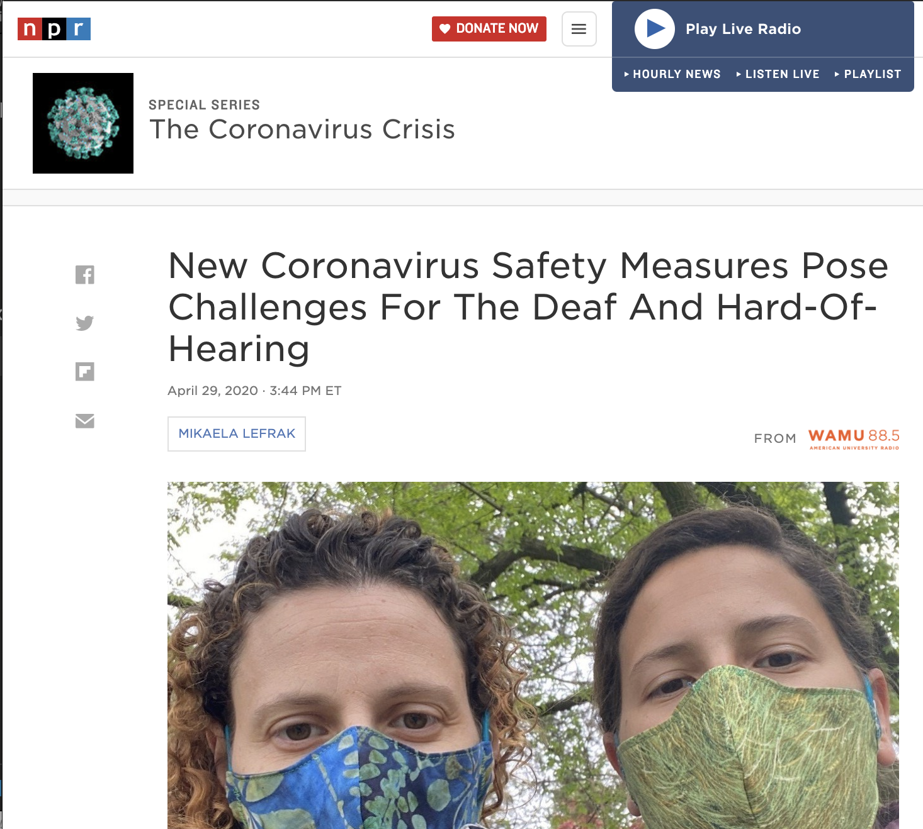
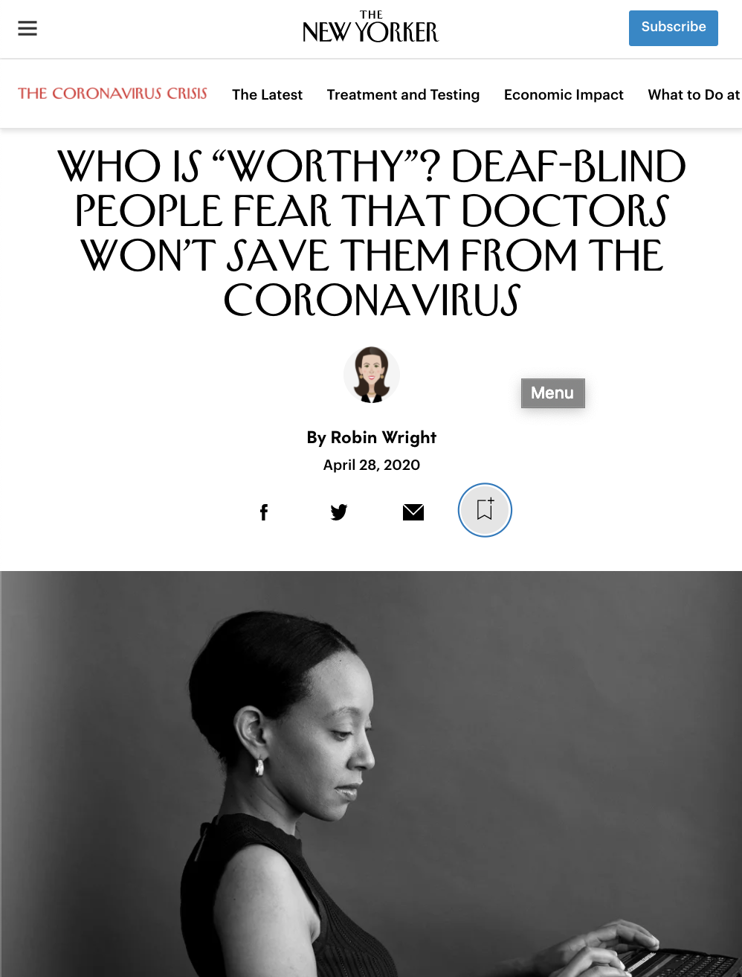
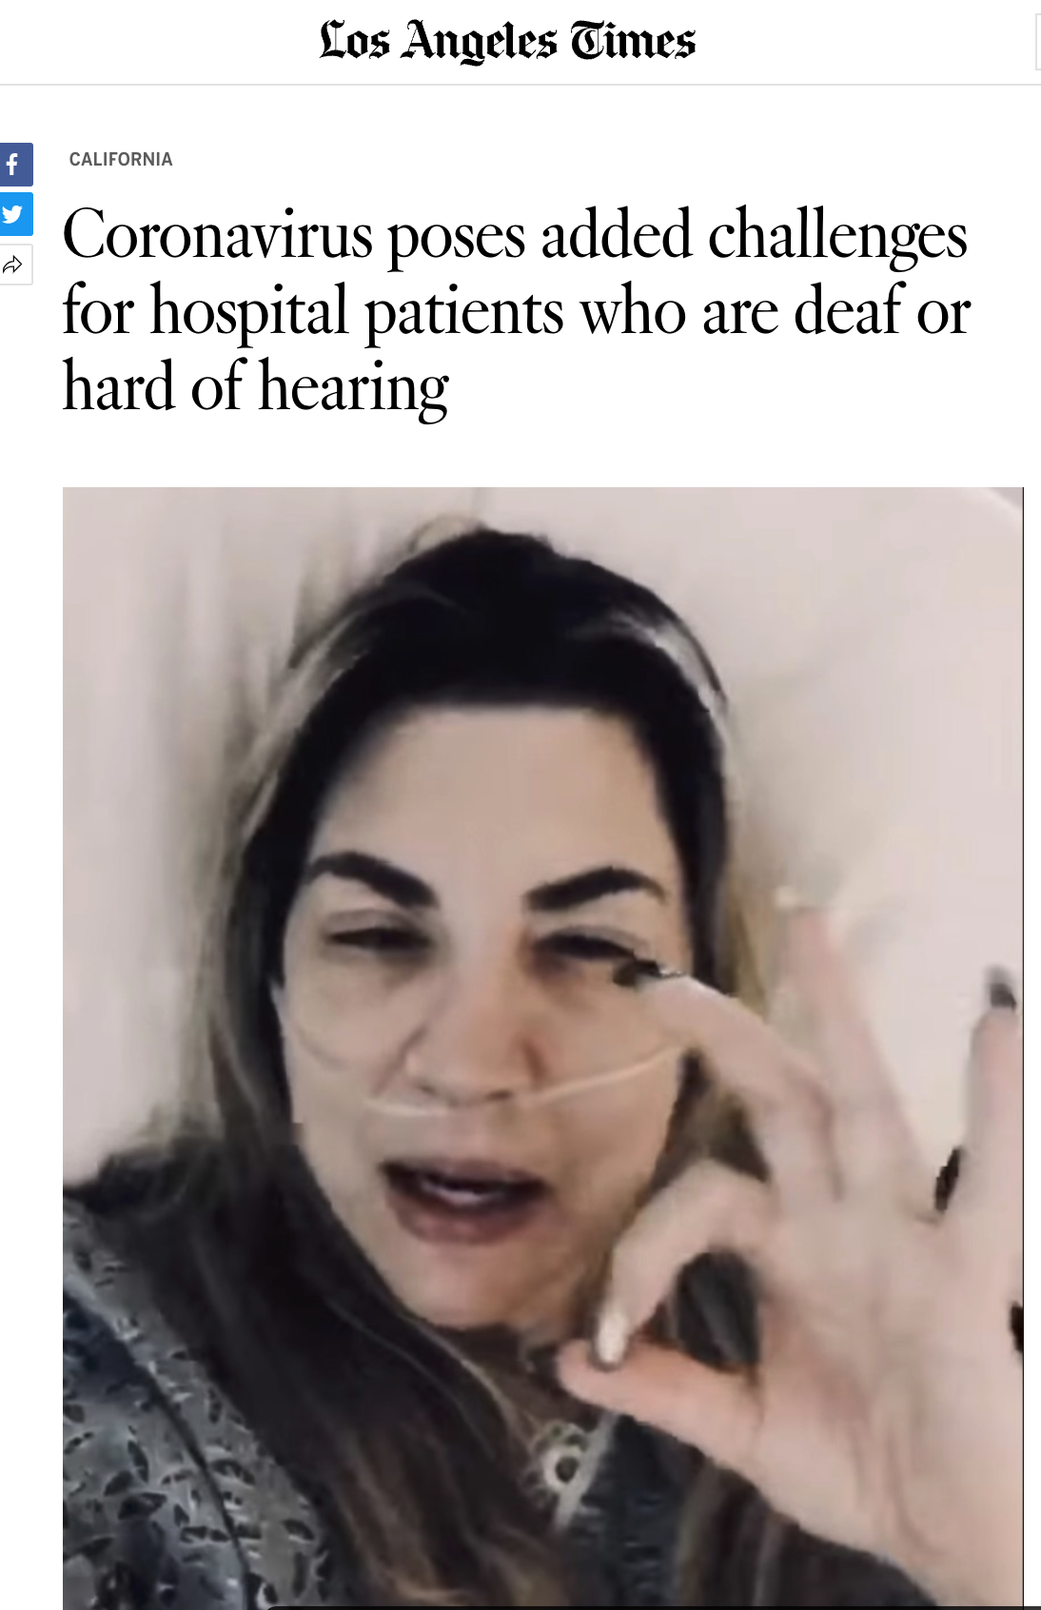
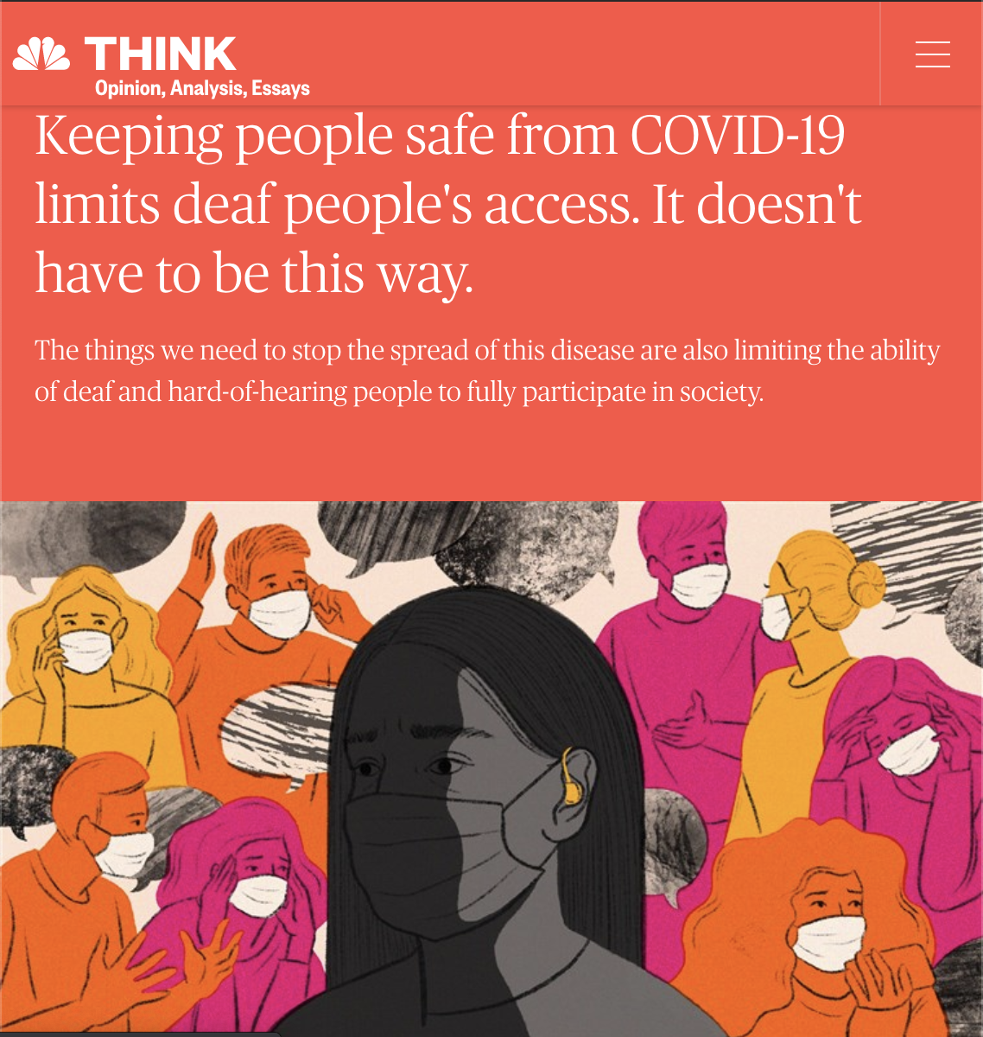
Cracks Revealed
Notes:
Hospitals and designated clinics set up to manage COVID-19+ patients have restrictions reducing the ability for DHH patients to communicate (e.g., face masks), often with no proposed solutions. These safety procedures designed to protect patients and health-care workers may interfere with accessible and effective communication, as required by the Americans with Disabilities Act. What we have seen is the widespread breakdown in communication across society. Even a simple trip to the store is now difficult for an individual such as myself due to masking. Masking is a critical tool to help reduce people’s risk for COVID-19 but we need to also decide how we can mitigate many of these added on issues. So, I want to talk briefly about a few of these strategies. Rather than dwell on the challenges, we can look at them as opportunities to greatly disrupt how we have largely done to communicate with these patients.
LA Times link- https://www.latimes.com/california/story/2020-04-16/coronavirus-deaf-hearing-hospitals-interpreters
NBC: https://www.nbcnews.com/think/opinion/keeping-people-safe-covid-19-limits-deaf-people-s-access-ncna1207371
NPR: https://www.npr.org/2020/04/29/847925057/new-coronavirus-safety-measures-pose-challenges-for-the-deaf-and-hard-of-hearing
New Yorker: https://www.newyorker.com/news/our-columnists/who-is-worthy-deaf-blind-people-fear-that-doctors-wont-save-them-from-the-coronavirus

Slide 68
Virtual Care Appointments
Ensure 3 way video visits (allows for interpreters to participate) or Zoom calls for CART additions
Video relay service (via telephone calls) uses non-medical certified interpreters
Loss of video with resulting reduction in info obtained
Lower provider-patient engagement
Notes:
Link for accessible zoom or virtual meetings/calls- https://www.deafhhtech.org/rerc/accessible-virtual-meeting-tips/
Virtual care appointments offers one way to avoid the masking situation. Yet, if not done right, can be another barrier. For example, Deaf signers require interpreters to be present for most appointments, unless the provider signs. If a video visit is set up, it is important to see if a 3 way video visit can be arranged. This would allow the simultaneous addition of interpreters in this visit. If this is not done, this will default to a telephone visit with a video relay service operator. This will lose the opportunity for the provider to see the patient which is extremely helpful to see how the patient is doing and also for rapport building. Also, video relay service operators or interpreters are not trained for medical environments. Many large platforms such as AmWell and Virtual Health do allow for 3 way video visits. These are often used for medical student education too. Explore this and use them.

Slide 69
Virtual Care Appointments

Slide 70
Telecommunication Relay Services
https://www.sorensonvrs.com/svrs
https://www.sprintrelay.com/services/sprint-accessibility-relay-services
3. https://www.captel.com/captel/#howitworks
Notes:
Remind them:
TRS- dial 711; CapTel- dial voice number is: 1-877-243-2823; VRS- dial patient’s phone number

Slide 71
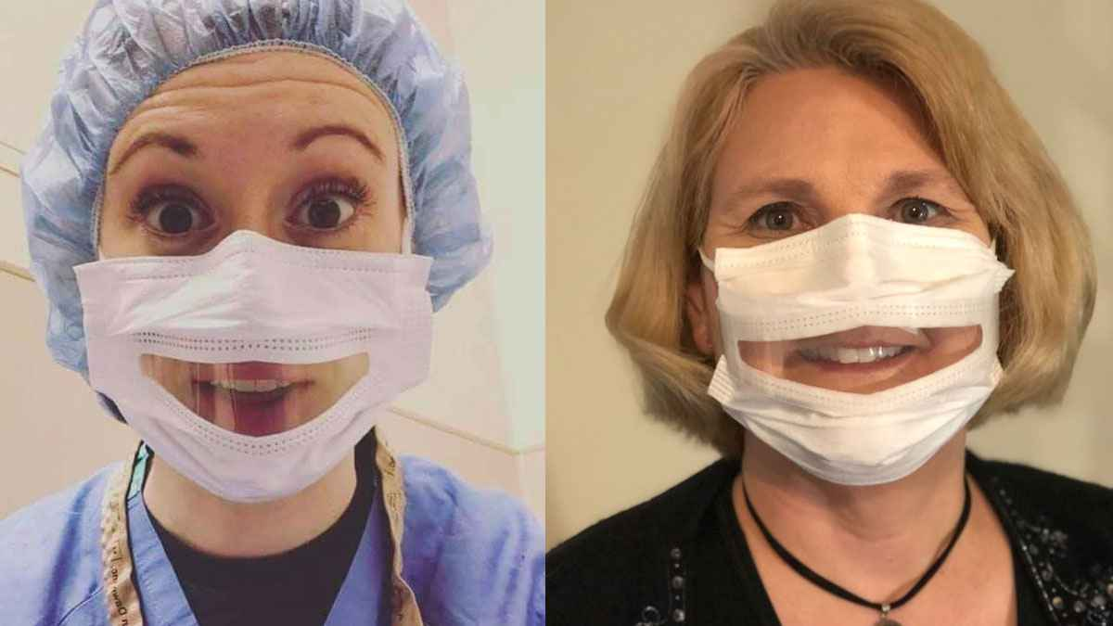
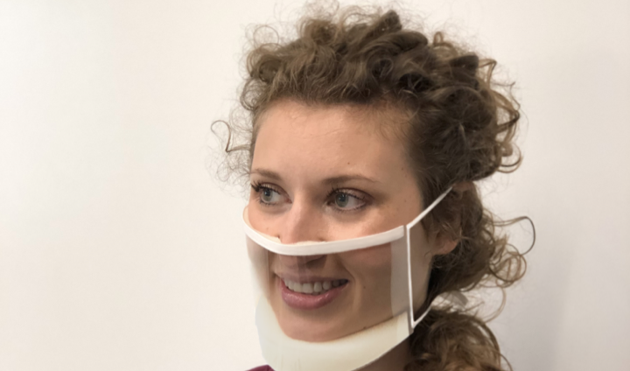
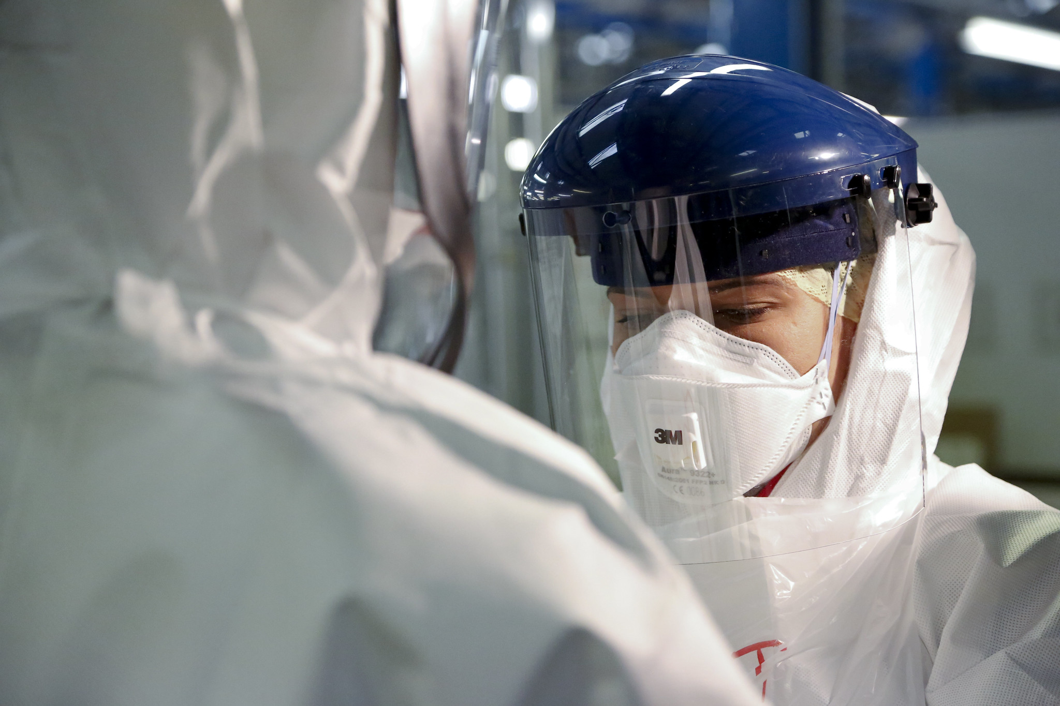
In-person patient care
Clear masks
Safe N’Clear
ClearMask
Aerosolized situations
Powered, air-purifying respirator is one option that could enable patients to see
Notes:
Additionally, the need for clear masks is exploding. There are fortunately two FDA approved mask suppliers- Safe N’Clear and ClearMask. Both provide a clear viewing of the lips which can be helpful for reading lips or expressions. These masks are also useful for children and for others with communication difficulties. Keep in mind that for highly aerosolized situations, we can’t use these, we need to consider the use of a powered, air-purifying respirator.

Slide 72
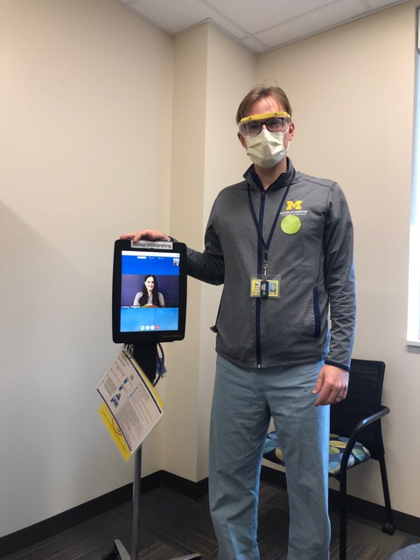
In-person patient care (cont)
Communication devices
Mobile carts/poles with iPad for video remote interpreting and/or CART
Deaf-blind
PPE for trained interpreters (limited availability)
Writing tablets/pads
Communication boards (e.g. boogie board
Signage
Notes:
Also, for in person care, another useful tool that we set up here at Michigan Medicine is the use of a Ipad mounted on mobile pole units. These units were used to provide remote interpreting for our patients. Our staff interpreters were able to call in this way while conserving our precious personal protective equipment early on. Our staff interpreters are now available to come in person since there are more availability to PPE and there are certain situations in which an interperter needs to be present (e.g. deaf-blind). Additionally, there are a number of other ways that can help. For example, there are writing tablets or communication boards. These are also called boogie boards and I do feel strongly they are needed at each inpatient unit. Lastly, I don’t want to discount the impact of properly placed signage showing that the patient is DHH. This has been shown to change the provider’s behavior and approach.

Slide 73
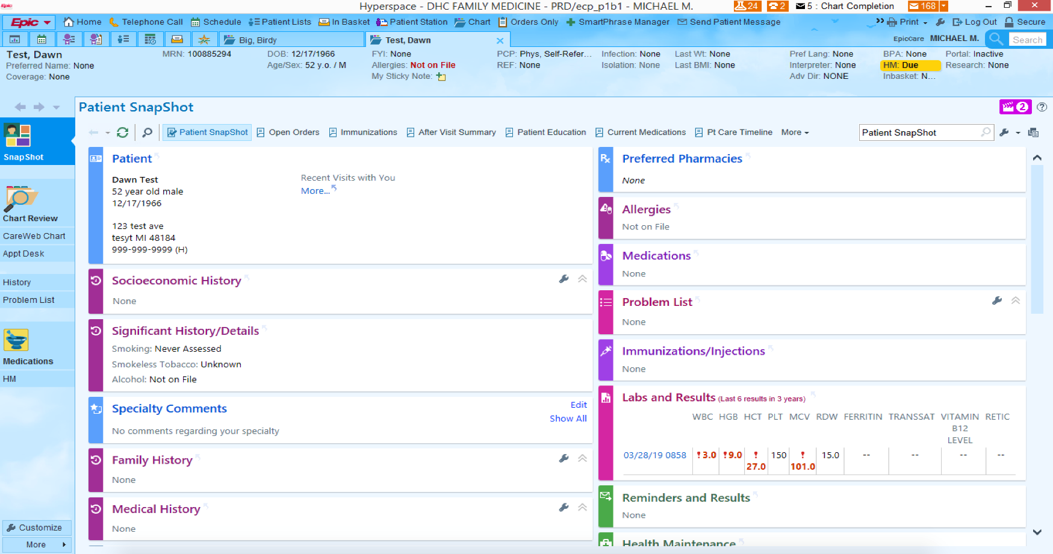
Chart Strategies
Notes:
This is an example of a fake patient to show where we can help us know if patients are DHH or have specific communication needs. The first box with the name of the patient, has a FYI box that can be a good spot for key info on how the patient prefers to communicate. The second box is useful for those who have language other than English, such as sign language users. Third, it is important to identify those in the problem list if they have a hearing loss. We will also be developing a needs box soon that will have disability related information that will be user friendly and more visible.

Slide 74
Screening of Patients
Screen all patients for limitations or communication barriers
Zazove P, Plegue MA, Kileny PR, McKee MM, Schleicher L, Green LA, Sen A, Rapai ME, Guetterman TC, Mulhem E. Initial results of the Early Auditory Referral-Primary Care (EAR-PC) study. Am J Prev Med. 2017;53(4):e139-146.
Notes:
Consider screening/prompts to identify at risk individuals- communication intakes in hospitals. We did this as part of a research project and while the intent was to improve screening rates to audiology to address unaddressed hearing loss. What we found is that a simple tool to improve screening also improved provider awareness that people had trouble hearing and also improved the charting of hearing loss in medical records. Electronic alerts, if used appropriately, can help rather than overwhelm our providers.

Slide 75
Remember the patient is generally the expert on what works best with communication!
Helpful Resources
https://www.nad.org/covid19-telehealth-access-for-deaf-hard-of-hearing/
The Joint Commission: Advancing Effective Communication, Cultural Competence, and Patient- and -Centered Care: A Roadmap for Hospitals. Oakbrook Terrace, IL: The Joint Commission, 2010.
2. McKee MM, Moreland, CJ, Atcherson SR, Zazove P. Hearing Loss: Communicating with the patient who is deaf or hard of hearing. FP Essent,2015;434:24-28.
Notes:
Remember the patient through their life experiences are often the experts! Ask them and learn!

Slide 76
Contact
Email: mmmckee@umich.edu
Twitter: Mike McKee @deafmd1
MDisability: @disability_UM
Deaf Health Clinic https://www.uofmhealth.org/our-locations/deaf-health
Notes:
Thank you for sticking with me over the hour and I am happy to answer any questions you may have. Also, feel free to reach out to me for additional info too.

Slide 77
Q&A Session

Slide 78
Next and Upcoming Sessions
November 10th, 2020: 11 AM – 12 PM PT
Licensure and Patient-Provider Relationship
Joseph McMenamin, MD, JD
Amanda Enyeart, JD
November Session – Part 2
Telehealth Legal Issues 101
November 18th, 2020: 11 AM – 12 PM PT
Topic: Liability and Privacy
Joseph McMenamin, MD, JD
Amanda Enyeart, JD

Slide 79
Thank you!

