Slide 1
Leveraging Telehealth to Address Social Determinants
November 19th, 2020

Slide 3
Webinar Tips and Notes
Your phone &/or computer microphone has been muted.
If we do not reach your question, please contact your regional TRC. There may be delays in response time: https://www.telehealthresourcecenter.org/contact/
Please fill out the post-webinar survey.
The webinar is being recorded.
Recordings will be posted to our YouTube Channel:
https://www.youtube.com/c/nctrc

Slide 4
Speakers
Christina Quinlan Director of Operations Islands Community Medical Services Inc.; Northeast Telehealth Resource Center Strategist
Reid Plimpton
Project Manager, Northeast Telehealth
Resource Center

Slide 5





About Us

Slide 6
Disclosures and Acknowledgements
Any information provided today is not to be regarded as legal advice
NETRC, nor do I personally, have any relevant financial interest, arrangement, or affiliation with any organizations related to commercial products or services discussed in this session.
Acknowledgement: Christina Quinlan, NETRC Consultant, Director of Operations at Islands Community Health Services

Slide 7
Contents
Telehealth versus telemedicine
Telehealth to reduce Social Determinants of health
Filling the Critical Gaps
Virtual Visit Algorithm
Nonclinical uses-Integrating Social Care back into Healthcare
Benefits

Slide 8

What is Telehealth?
Broadly: the provision of health care, public health, and health education at a distance using telecommunications technologies.
Also Known As:
Telemedicine
Telepractice
Tele-X (specialties like telepsychiatry)
Virtual Health
Digital Health
eHealth
eVisits
And more!
Largely embraced opinion:
Telehealth is not a service or medical specialty, but a tool used to deliver care.
Telehealth vs. Telemedicine
While “telemedicine” has been more commonly used in the past, “telehealth” is a more universal term for the current broad array of applications in the field.

Slide 9
Considerations for Telehealth from Home
Patients
Both
Providers
Ease of use
Access to technology
Access to internet
Continuity of care
Privacy/security concerns
Provider & staff training
Legal and regulatory
Licensure barriers
Evolving policy
Others?
Digital literacy
Technology Support
Supports for disabilities
Interpreting services

Slide 10
Telehealth to Address Social Determinants…
Start Here:
• Use Community and Patient Needs Surveys to Identify Patients who Would Benefit from Telehealth Services:
- Patients who identify transportation as a barrier to accessing care
- Older adults with limited mobility
- Lack of insurance
• Improving access to, effects of, and value of healthcare services
• Chronic care management among special populations
• Provide remote access to specialists in rural and underserved settings
• Provide healthy weight and physical activity counseling
• Eligibility and enrollment
1. LEATH, B. A., DUNN, L. W., ALSOBROOK, A., & DARDEN, M. L. (2018). ENHANCING RURAL POPULATION HEALTH CARE ACCESS AND OUTCOMES THROUGH THE TELEHEALTH ECOSYSTEM™ MODEL. ONLINE JOURNAL OF PUBLIC HEALTH INFORMATICS, 10(2), E218. DOI:10.5210/OJPHI.V10I2.9311

Slide 11
Get Paid Here…
• As of December, 2019 - 42 out of 50 states and DC maintain a telehealth commercial payer statute
• 29 states, including DC have payment parity
• Originating (patient) sites may bill the facility fee (Q3014) in many cases
Train your team: LCSWs, RNs, MAs, etc.
• Most commercial payers pay for the following screenings and services:
- SBIRT: 99408-99409: $29.67, $57.23 (G0442 & G0443)
- DAST
- AUDIT
- Tobacco cessation
- Development screenings: 96110: $5-$60 (2 UNITS ALLOWED)
- Including MCHAT

Slide 12
Get Paid Here…
- Emotional and Behavioral Health Screenings: 96127
- PHQ-9: G0444 (PPS RATE for FQHCs)
- Vanderbuilt
- GAD
- Behavior Counseling on Obesity: G0447 - 15 MINUTES

Slide 13

Hot off the Presses
New October 14!
Some of the new services include:
93797: Cardiac rehab;
93798: Cardiac rehab/monitor;
93750: In-person ventricular assist device interrogation;
95970: Electronic analysis of implanted neurostimulator pulse without programming;
95971: Electronic analysis of implanted neurostimulator pulse generator/transmitter with programming;
G0422: Intensive cardiac rehab with exercise;
G0423: Intensive cardiac rehab, no exercise; and
G0424: Pulmonary rehab with exercise.
Full List of Medicare Telehealth Services (updated 10/14/2020)
New State Medicaid and CHIP Telehealth Toolkit: Policy Considerations for States Expanding Use of Telehealth, COVID-19 Version
Notes:
The added services primarily cover cardiac rehabilitation, and point to an increased interest among healthcare providers to use remote patient monitoring platforms to improve care management for cardiac care patients at home. They also nod to recent studies suggesting that patients with cardiac issues aren’t accessing routine checkups and other services during the pandemic, putting them at higher risk of a serious health issue.

Slide 14
Filling Critical Gaps
Provide episodic care for low-acuity health conditions
Medication adjustment therapy – SUD Services (Patient’s home is allowed as originating side – Post COVID?)
Follow-up to labs (point of care decisions are easily made when labs and vital have been completed
  TURN A TELEPHONE CALL INTO A TELEHEALTH VISIT!
• Chronic Care Management (especially with recent labs and vitals)
• Decrease no-show rates!

Slide 15
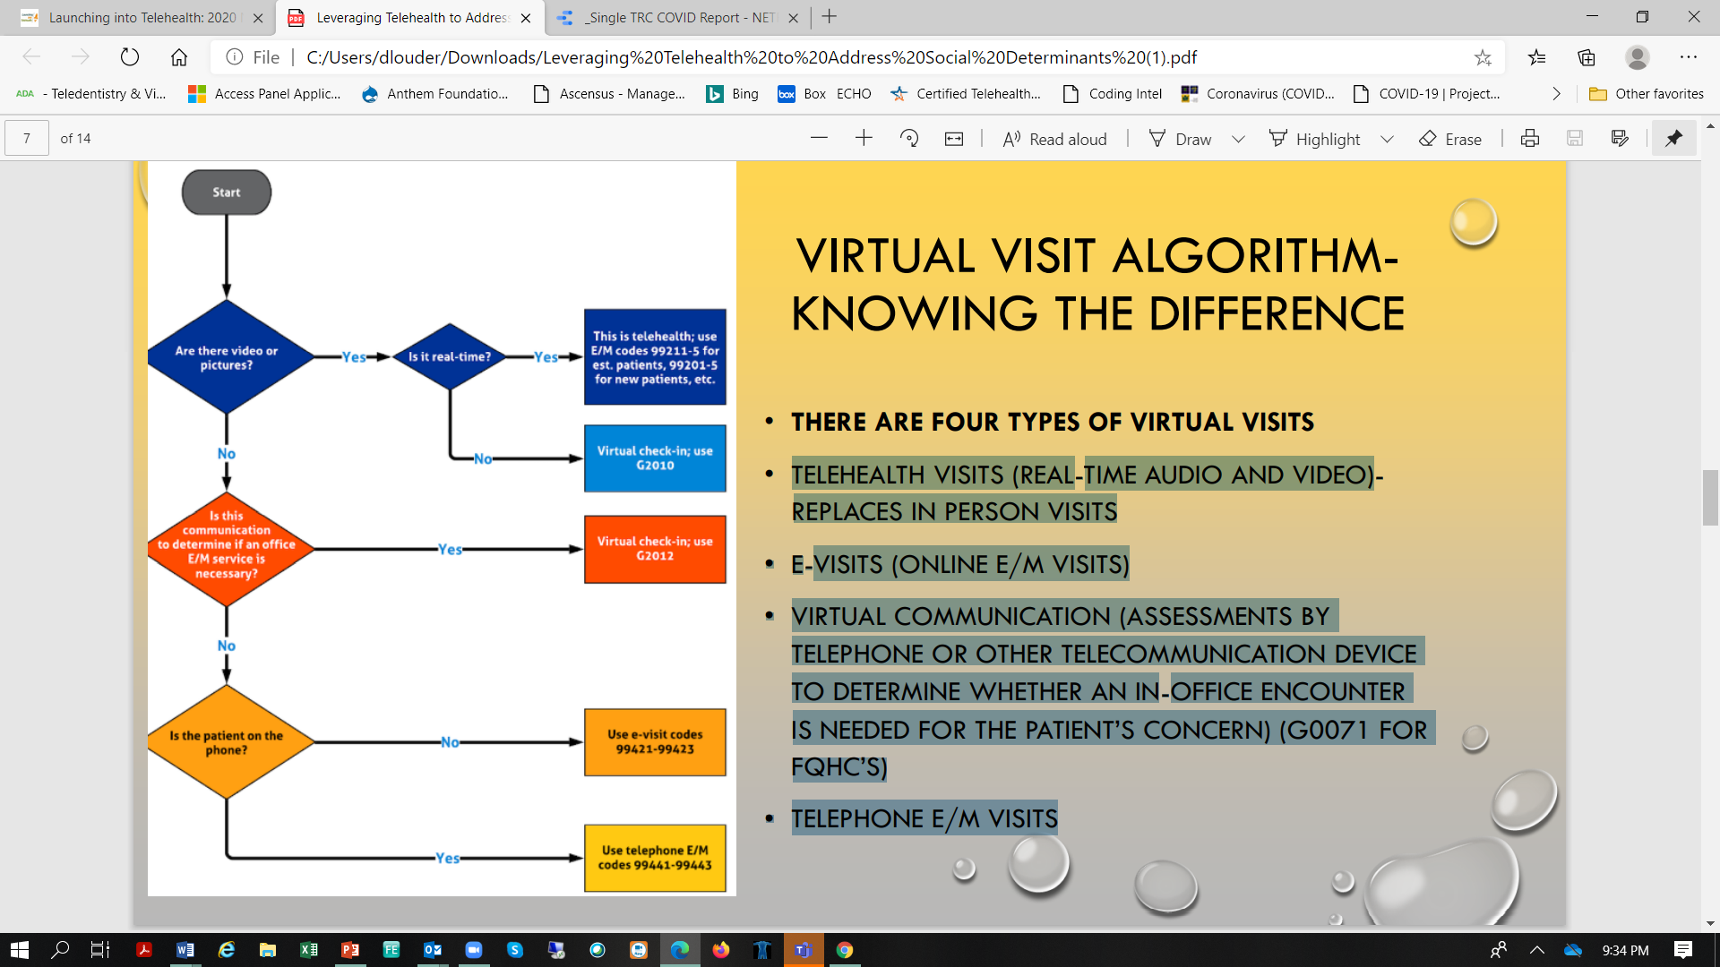
Virtual Visit Algorithm – Knowing the Difference
Four Types of Telehealth Visits:
Telehealth Visits (real time audio/video; replaces in-person)
E-Visits (Online E/M Visits)
Virtual Communication (assessments by telephone or other telecommunication devices to determine whether in-person visit is needed) (G0071 for FQHCs)
Telephone E/M Visits

Slide 16
Non-Clinical Uses – Integrating Social Care
Traditional reimbursement may not always be there, but Value is!
Linking medical and non-medical services can help providers meet their bottom line
How? Awareness-Adjustment-Assistance-Alignment & Advocacy
Case Management
• Patients can meet with WIC counselor for WIC services, without burden of finding transportation
• Parolees can meet with their probation officer
• DHHS-parents can meet with their case worker to increase chances of reunification with children
• OutReach
  • Housing assistance
  • Eligibility assistance
  • Health Educators
https://www.nationalacademies.org/our-work/integrating-social-needs-care-into-the-delivery-of-health-care-to-improve-the-nations-health#:~:text=Integrating%20Social%20Care%20into%20the,to%20Improve%20the%20Nation's%20Health&text=This%20recognition%20has%20been%20bolstered,rather%20than%20service%20delivery%20alone

Slide 17
Benefits
The current shift to alternate payment models led by CMS, aligns incentives for the provision of social care.
Reducing social determinants of health
Increase primary and specialty care, especially in rural settings
Increase social care activities that address health-related social risk factors and social needs
Increase continuity of care
Improve patient engagement
Collaborative partnerships
Commitment to health equity

Slide 18
Telehealth offers flexibility & Affordability
Value-based care will require telehealth
Telehealth helps increase health care value and affordability
Virtual care technology saves patients time and money
Telehealth health visits have a lower no-show rate
About 20% of Americans live in rural areas without easy access to specialty services
Improved team-based care
Reduce no-show rates
May solve staffing shortages

Slide 19

COVID and the Future of Telehealth
Now that the genie is out of the bottle…
We can’t expect “business as usual” when the pandemic is over:
How will we prepare for a tsunami of patients who have delayed care…and for those who may continue to delay care?
How will we fix “sloppy” telehealth?
Now that providers and patients have gotten a taste of telehealth, will we be able to go back to our pre-existing policies? Should we?
Notes:
Evaluating Disparities and Outcomes of Telehealth During the COVID-19 Emergency Act of 2020,

Slide 20

Tips to Get Started
Find a champion
Think big, Start small
  Focus time, effort and $ on program development and a sustainable business model, then choose technology that fits your plan
Keep technology simple when possible – what fits your needs and budget?
  Reach out to folks who have already done this!
  Lead advocacy efforts for program development and policy growth
Notes:
Evaluating Disparities and Outcomes of Telehealth During the COVID-19 Emergency Act of 2020,

Slide 21
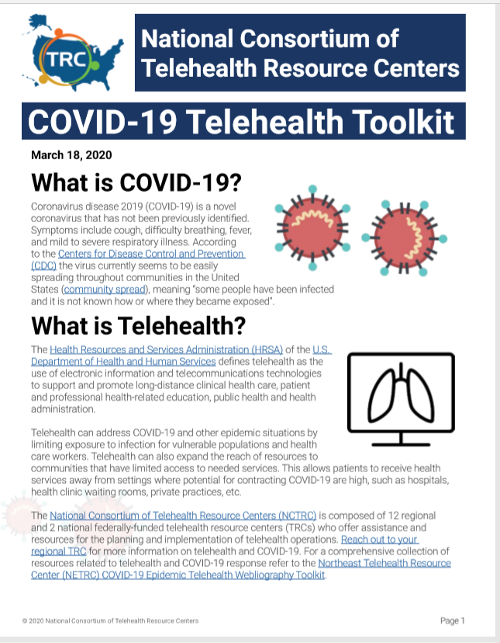
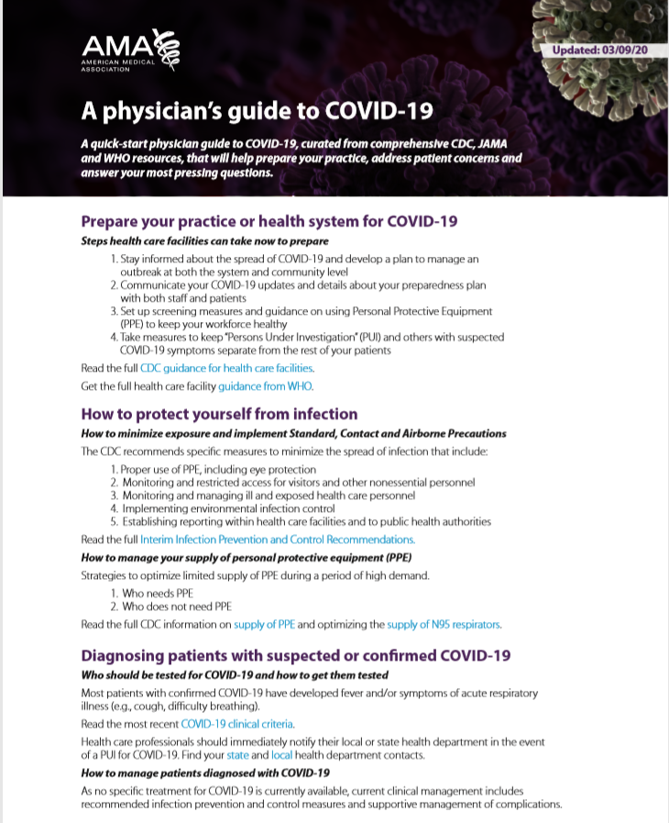
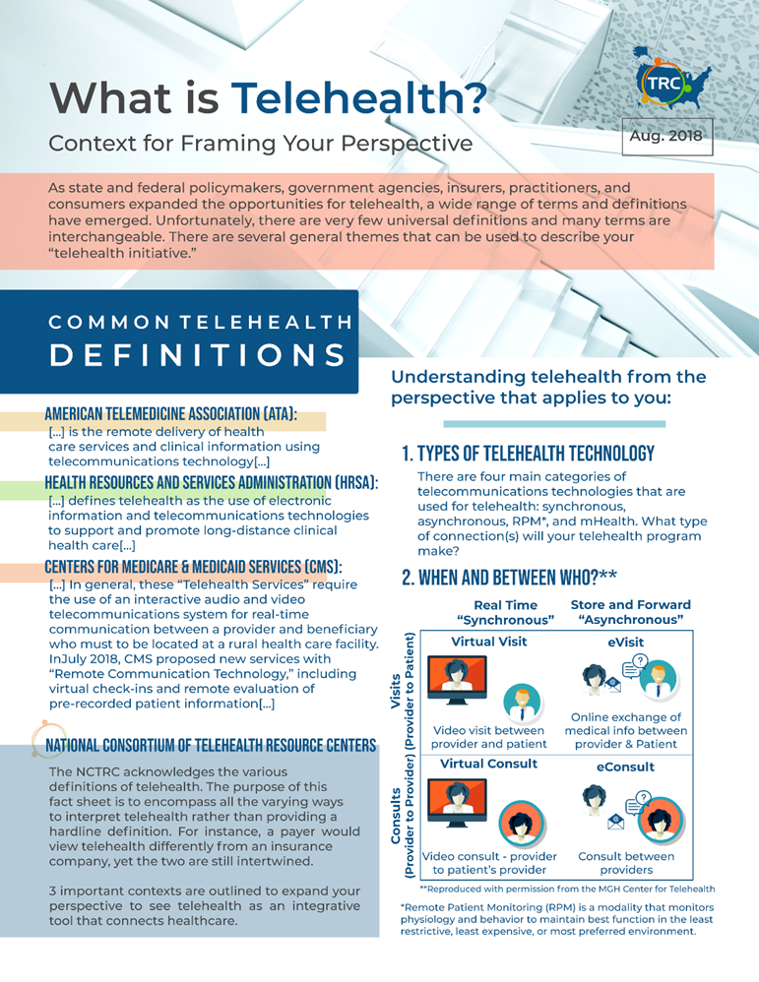

Select Resources for COVID-19
NETRC Site & Telehealth Resource Library
  Telehealth Coordinator eTraining, developed w/California TRC
  Northeast Telehealth Resource Center COVID-19 Toolkit
National Telehealth Resource Center website
  Telehealth and COVID-19 Toolkit
  NCTRC Telehealth and COVID-19
CMS General Provider Telehealth & Telemedicine Toolkit
MATRC Telehealth Resources for COVID-19
NRTRC Quick Start Guide to Telehealth
AMA: A Physician’s Guide to COVID-19
Hooper, Lundy and Bookman: COVID-19 Resource Page
Notes:
Evaluating Disparities and Outcomes of Telehealth During the COVID-19 Emergency Act of 2020,

Slide 22
Policy and Reimbursement Resources
CMS/Medicare - COVID-19 Emergency Declaration Blanket Waivers for Health Care Providers
Medicare Telemedicine Health Care Provider Fact Sheet
Medicare Learning Network (MLN) Booklet – 2020
Medicare - Covered Telehealth Services CY2019 and CY 2020
Office of Civil Rights
FAQs on Telehealth and HIPAA during COVID-19 public health emergency
DEA COVID-19 Information Page
SAMHSA COVID-19 Page
Center for Connected Health Policy
Telehealth Coverage Policies in the Time of COVID-19
COVID-19 Related State Actions
Billing For Telehealth Encounters – CCHP 2020 Guide on Fee-for-Service
Federation of State Medical Boards – Board by Board Review
States Waiving Licensure Requirements During COVID-19
Notes:
Evaluating Disparities and Outcomes of Telehealth During the COVID-19 Emergency Act of 2020,

Slide 23
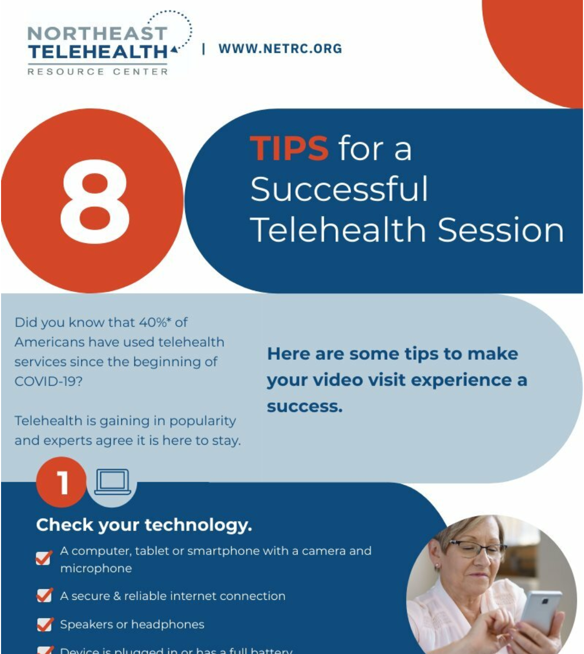
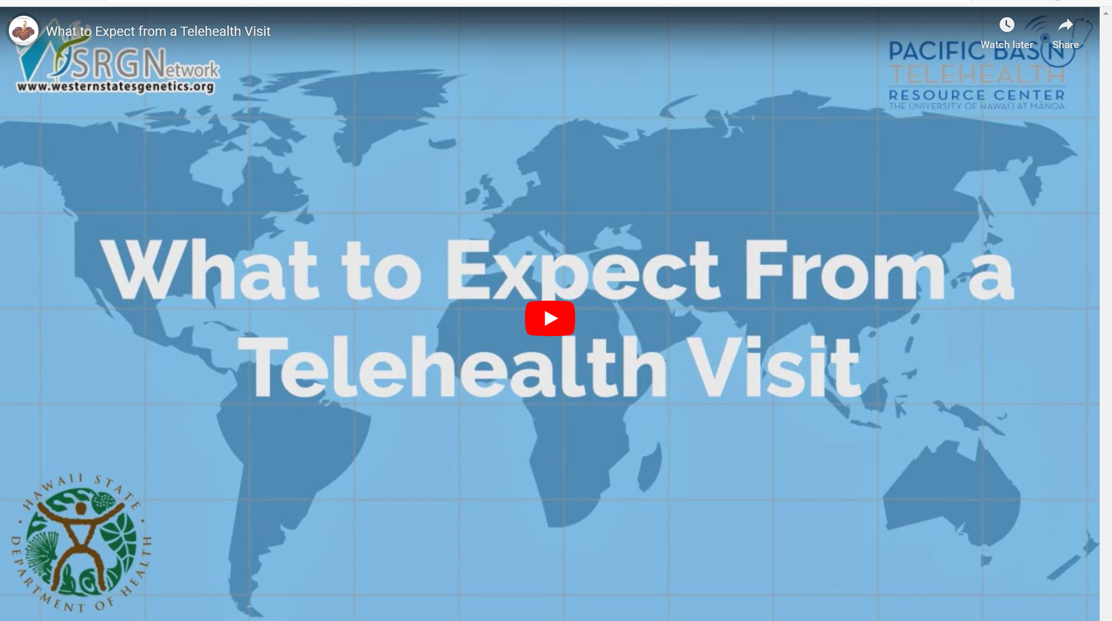
Patient & Provider Resources
FCC LifeLine Program, which provides devices and subsidies on monthly voice and data fees for low income consumers. There are eligibility requirements (see webpage) and an application process for this.
National Digital Equity Center
More resources for Devices:
- Give It – Get It
Goodwill’s Good Tech Program
Provider Telehealth Best Practices: http://bit.ly/providerbestpractice
Sample Provider Etiquette: http://bit.ly/provideretiquette
What Patients can expect: http://bit.ly/telehealthexpectations
Sample Patient Tips for Telehealth: http://bit.ly/tipsfortelehealth
HHS Telehealth Webpage for Patients: https://telehealth.hhs.gov/patients/
NCTRC Patient Engagement: https://www.telehealthresourcecenter.org/wp-content/uploads/2020/03/How-Patients-Can-Engage-Telehealth-FINAL.pdf
Notes:
Evaluating Disparities and Outcomes of Telehealth During the COVID-19 Emergency Act of 2020,

Slide 24
Our Next Webinar
The NCTRC Webinar Series
Occurs 3rd Thursday of every month.
Telehealth Topic: TBD
Date: January 21st, 2021
Times: : 11 AM – 12 PM (PT)

Slide 25
Please Complete Our Survey
Your opinion of this webinar is valuable to us.
Please participate in this brief perception survey (will also open after webinar):
https://www.surveymonkey.com/r/XK7R72F

Slide 26

Join our newsletter!
Questions?
Thanks for Listening!
www.netrc.org | 800-379-2021

Slide 27

Thank You!
www.NETRC.org
800-379-2021
Join our newsletter!

