Slide 1


NCTRC Telehealth Hack Series
Setting Your Campus Telemental Health Program Up for Long Term Success
December 10th, 2020

Slide 2
NCTRC Telehealth Hack Data
The National Consortium of Telehealth Resource Centers collects registration, participation, questions/answers, chat comments, and poll responses for this program and shares this data with the HHS – Health Resources and Services Administration (HRSA). Your individual data will be kept confidential. These data may be used for reports, maps, communications, surveys, quality assurance, evaluation, research, and to inform new initiatives

Slide 4
Transitioning from HHS - ASPR
The National Consortium of Telehealth Resource Centers (NCTRC) have played an active role throughout the legacy HHS – ASPR Telemedicine Hack series. With the program becoming widely popular, HHS – ASPR has agreed to transition the program to the NCTRC.
With the Telehealth Hack program now fully transitioned, the NCTRC will provide peer-to-peer learning sessions through March 2021, covering core topics and specialties where telehealth is utilized.

Slide 5
Webinar Tips and Notes
Your phone &/or computer microphone has been muted.
Please place your questions into the Q&A function.
For technical assistance with Zoom, please use the Chat function.
Attendees are able to adjust video sizing via Zoom’s sliding feature.
Attendees can toggle Closed Captioning in the toolbar.
The webinar is being recorded.
Recordings will be posted to our website and YouTube Channel:
www.telehealthresourcecenter.org
https://www.youtube.com/c/nctrc

Slide 6




UAMS Disclosure Policy
It is the policy of the University of Arkansas for Medical Sciences (UAMS) to ensure balance, independence, objectivity, and scientific rigor in all directly or jointly provided educational activities.
All individuals who are in a position to control the content of the educational activity (course/activity directors, planning committee members, staff, teachers, or authors of CE) must disclose all relevant financial relationships they have with any commercial interest(s) as well as the nature of the relationship. Financial relationships of the individual’s spouse or partner must also be disclosed, if the nature of the relationship could influence the objectivity of the individual in a position to control the content of the CE. The ACCME and ACPE describe relevant financial relationships as those in any amount occurring within the past 12 months that create a conflict of interest. Individuals who refuse to disclose will be disqualified from participation in the development, management, presentation, or evaluation of the CE activity.

Slide 7
Disclosures
The following planners and speakers of this CE telehealth series and activities have no relevant financial relationships with commercial interests to disclose:
Aria Javidan, MPH
Mei Kwong, JD
Joseph McMenamin MD, JD
Amanda Enyeart, JD
Kathy Wibberly, PhD
Doris Barta, MHA
Nichole Perisho
Becky Bounds
Jordan Berg
Alysa Bass, JD
Clarette Yen, JD
Jason Jent, PhD
Michael McKee, MD
Michael Deichen, MD
Kimberly Tilley, MD
Augustus Jordan, PhD
Joy Himmel, Psy.D
Jay Ostrowski
Kathy Chorba
Danielle Louder
The accreditation compliance reviewer, Courtney Bryant, has no financial relationships with commercial interests to disclose.

Slide 8
Joint Accreditation and Credit Designation Statements
Joint Accreditation Statement
In support of improving patient care, this activity has been planned and implemented by the University of Arkansas for Medical Sciences and National Consortium on Telehealth Research Centers. University of Arkansas for Medical Sciences is jointly accredited by the Accreditation Council for Continuing Medical Education (ACCME), the Accreditation Council for Pharmacy Education (ACPE), and the American Nurses Credentialing Center (ANCC) to provide continuing education for the healthcare team.
AMA Credit Designation Statement
The University of Arkansas for Medical Sciences designates this live activity for a maximum of 1.0 AMA PRA Category 1 CreditsTM. Physicians should claim only the credit commensurate with the extent of their participation in the activity.
ACPE Credit Designation Statement
These knowledge based activities will provide pharmacists up to 1.0 contact hours or 0.1 CEU. CE credit information, based on verification of live attendance and completion of the program evaluation, will be provided to NABP within 60 days after the activity completion.

Slide 9
Joint Accreditation and Credit Designation Statements
Joint Accreditation Statement
In support of improving patient care, this activity has been planned and implemented by the University of Arkansas for Medical Sciences and National Consortium on Telehealth Research Centers. University of Arkansas for Medical Sciences is jointly accredited by the Accreditation Council for Continuing Medical Education (ACCME), the Accreditation Council for Pharmacy Education (ACPE), and the American Nurses Credentialing Center (ANCC) to provide continuing education for the healthcare team.
ANCC Credit Designation Statement
The University of Arkansas for Medical Sciences designates this live activity for a maximum of 1.0 ANCC contact hours. Nursing contact hours will be awarded for successful completion of program components based upon documented attendance and completion of evaluation materials.
AAPA Credit Designation Statement
The University of Arkansas for Medical Sciences has been authorized by the American Academy of PAs (AAPA) to award AAPA Category 1 CME credit for activities planned in accordance with AAPA CME Criteria. This activity is designated for 1.0 AAPA Category 1 CME credits. PAs should only claim credit commensurate with the extent of their participation.

Slide 10
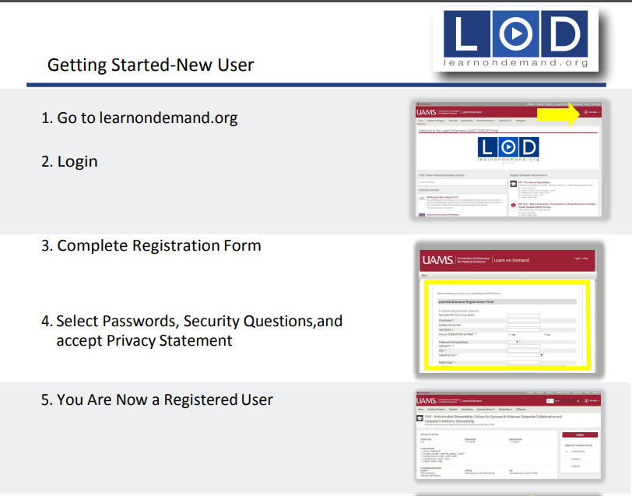
New to Learn on Demand (LOD)?
Create your Profile
https://uams.community360.net/content/uams/LODNewUser.pdf

Slide 11
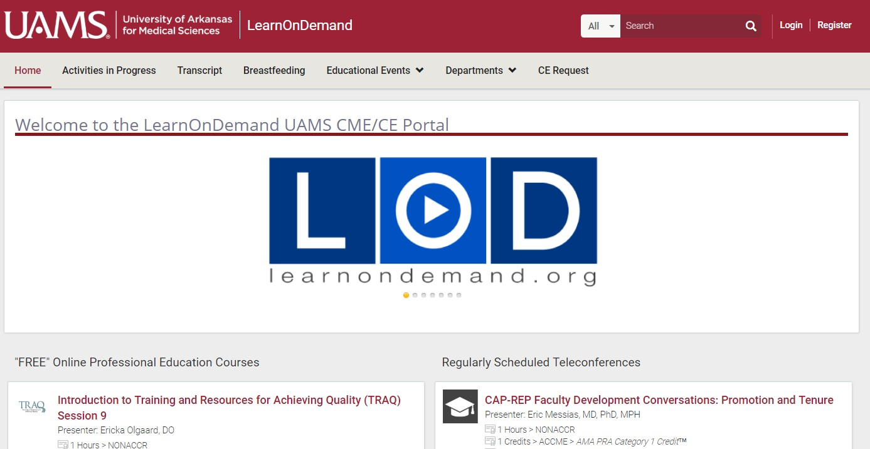

Certificates in LOD
In order to receive your CE credit:
Login to https://learnondemand.org
with your new or existing login.
Search for the Topic
Launch, Evaluate, click continue to print your certificate.

Slide 12
Deadline!!!
All evaluations must be completed by
Thursday, December 24, 2020
If you do not complete an evaluation by this deadline, you will not receive continuing education hours for this conference.

Slide 13
Course Evaluation & CE Certificate
Deadline is December 24, 2020
www.learnondemand.org
Questions about evaluations and/or certificates should be directed to IDHIeducation@uams.edu
or 1-855-234-3348

Slide 14
Today’s Agenda
Didactic #1 (12 min) – Joy Himmel, Psy.D
  Q&A Follow-up (5 min) – Moderated by Dr. Christian Ramers.
Didactic #2 (12 min) – Jay Ostrowski
  Q&A Follow-up (5 min) – Moderated by Dr. Christian Ramers.
Didactic #3 (12 min) – Kathy Chorba
  Q&A Follow-up (5 min) – Moderated by Dr. Christian Ramers.
Closing Remarks – Danielle Louder (4 min)

Slide 15

Facilitator Introduction
Christian B. Ramers, MD, MPH, AAHIVS – Biosketch
Dr. Ramers is the Chief of Population Health and Director of Graduate Medical Education at the Family Health Centers of San Diego (FHCSD), a large Federally Qualified Health Center (FQHC) system serving nearly 200,000 medically underserved individuals throughout San Diego county. He is board certified in Internal Medicine, Infectious Diseases, and Addiction Medicine, and is particularly interested in HIV, HBV, HCV, and service of medically underserved, immigrant, and refugee populations. He co-chairs the California Chapter of the American Academy of HIV Medicine and has advocated for HIV/HCV care at the state legislative level. He has served as a consultant for CDC-sponsored HIV/HBV/HCV educational projects in Asia and Africa. Since 2018 he has served as the Senior Clinical Advisor for the Clinton Health Access Initiative’s Global Hepatitis Program, working to eliminate HBV and HCV in seven partner countries in Asia and Africa.

Slide 16
setting Your Campus Telemental Health Program Up for Long Term Success
December 2020

Slide 17
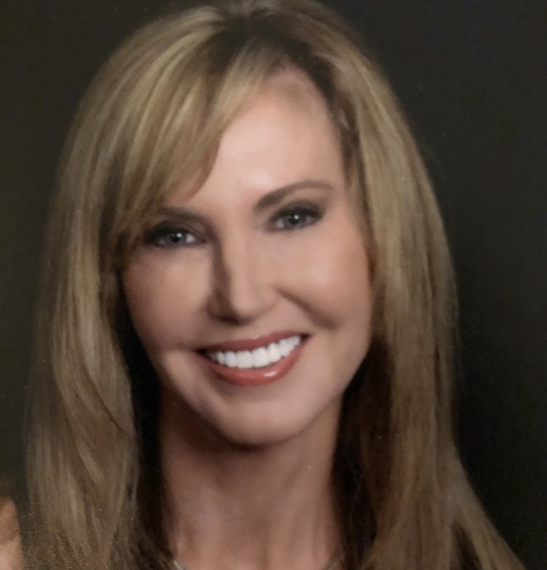
Joy Himmel, Psy.D, LCPC, NCC, RN,FACHA
American College Health COVID-19 Task Force
AAAHC Site Surveyor and Board Member

Slide 18

Objectives
Describe the ongoing benefits and challenges of sustaining telehealth services.
Identify how accreditation standards apply to telemental health services
Describe future mental health services models

Slide 19
Internet Access
Pew Research Center surveys, 2001 – 2019.
Notes:
Source:

Slide 20
Spring 2020
Of the 41.8 percent of students who attempted to seek mental health care during the pandemic, 23.3 percent said it had been “much more difficult” to access care, and 36.8 percent said it was “somewhat more difficult” (ACHA.org)
A higher proportion of students -- 30.5 percent compared to 21.9 percent the prior fall -- reported that their mental health negatively affected their academic performance on at least six days during the prior four weeks (Healthy Minds Network, May 2020).
Notes:
We know that the mental health needs are great in light of COVID.
The Healthy Minds Network, in collaboration with the American College Health Association -March and May 2020-about half the students who sought out treatment found accessing care to be more difficult.
And A higher proportion of students -- 30.5 percent compared to 21.9 percent the prior fall -- reported that their mental health negatively affected their academic performance on at least six days during the prior four weeks (Healthy Minds Network, May 2020).

Slide 21
Resource challenges
571 counseling center directors, (AUCCCD, 2019), only 7.6 percent conducted telephone counseling sessions, and 3.4 percent used video sessions.
While nine in 10 campus leaders say mental health is their top concern, fewer than two in 10 say their institution has invested in more mental or physical health resources in response to COVID-19. (Inside Higher Ed; March 2020)
    https://www.aucccd.org/assets/documents/Survey/2019%20AUCCCD%20Survey-2020-05-31-PUBLIC.pdfCollege presidents(insidehighered.com)
Notes:
Resource challenges:
571 counseling center directors, (AUCCCD in 2019), only 7.6 percent conducted telephone counseling sessions, and 3.4 percent used video sessions.
While nine in 10 campus leaders say mental health is their top concern, fewer than two in 10 say their institution has invested in more mental or physical health resources in response to COVID-19. (Inside Higher Ed; March 2020

Slide 22
Fall 2020
College counseling
62.6% provided mostly telemental health services with only limited face-to-face sessions
29.9% provided only telemental health services
Only 18.1% planning to return to pre-pandemic status
COVID-19 Resources and Alerts (acha.org)
Notes:
62.6% provided mostly telemental health services with only limited face-to-face sessions
29.9% provided only telemental health services
Only 18.1% planning to return to pre-pandemic status

Slide 23
Benefits of Continuing Telehealth
Improved access to care- lower bar
Increases help-seeking due to less barriers
Decreased stigma; students with marginalized identities
Safety of staff and students
Convenience
Improved attendance
Improved client satisfaction: flexibility of scheduling
Access to specialty care
Notes:
Improved access to care
Increases treatment seeking due to less barriers
Decreased stigma- clients often do not want to be heard or seen accessing services
Safety of staff and students
Convenience
Improved attendance
Improved client satisfaction: Gas costs, flexibility of scheduling
Access to specialists

Slide 24
Challenges
Interjurisdictional laws; reciprocity across state lines
Missing-the shared presence or surroundings, the human energy
Not suitable for all patients
Strength of internet connection, Broadband vs. Bandwidth
Privacy/HIPAA Risk assessments, Covered entities -Business Associate Agreements with vendors
Insurance billing
Need for ongoing training on how to conduct videoconferencing
Notes:
Interjurisdictional laws/ license reciprocity; it's important to know the Originating Site (where the client is located at the time of the appt) and Distance site where you are; Both states have jurisdiction over the professional relationship. Think about state laws which vary on mandated reporter, Duty to warn, liability, licensing
Limitations of video conferencing- missing the shared experience and surroundings and the human energy
Not Suitable for all clients: Complex presentations, EMDR, Hypnotherapy, Role Play, determine the suitability of text-based services
Strength of the internet connection; DSL, Cable, Fiber optic
Band width and speed matters: Broadband is a band of frequencies that allow many different types of traffic to be sent or received at the same time; Bandwidth is capacity
There are additional risk factors, need to do regular risk assessments
Business Associate Agreement: An entity that performs certain functions that involve the use or disclosure of PHI; you must have a legal contract that outlines ways the business associates must follow HIPAA
Insurance billing
The need for ongoing education and training on ethical and legal considerations of telehealth and best practices

Slide 25
Accrediting Bodies
AAAHC
Joint Commission
IACS
Notes:
The major accrediting bodies for college counseling centers are listed here. As we continue to grow and enhance our efforts in telehealth we need to do so with attention and compliance with the standards of care. I will focus on AAAHC, although there is a fair amount of consistency between them.

Slide 26
AAAHC Chapter 1: Rights and Responsibilities
1.A.4: Patients are given the opportunity to participate in decisions involving their health care
1.B: Patients are Informed of their rights and responsibilities
  Responsibilities: private location, internet access, camera and microphone, low distractions, appropriate attire, agreement to provide crisis contacts and location
  Obtaining consents in a virtual environment
  Authenticating the identity of your patient/client
Notes:
Chapter 1: Patient Rights and Responsibilities
Patients are given the opportunity to participate in decisions involving their health care
Patients are Informed of their rights and responsibilities
Right to an alternate modality, right for privacy right to consent-
Responsibilities: private location, internet access, camera and microphone, low distractions, appropriate attire; agreement to provide crisis contacts
The responsibility to participate with Authenticating patient identity with visits- at least two patient identifiers

Slide 27
AAAHC Chapter 17.J : Informed Consent
Scope of services
Describe the limitations of privacy in a virtual environment
Restrictions on recording and posting
Alternatives to virtual sessions
Benefits/Threats
Disconnection of service
Emergency situations: consent for two emergency contacts
Methods of communication between sessions– chat, messaging, email
Conditions to breach
Notes:
Informed consent
Scope of services
Limitations of privacy: Internet breaches, people accessing the internet from public locations (unsecured networks); position the screen so that other's don't see it (computer labs, café's)
Restrictions on recording and posting, use of social media
Acknowledging that there are Alternatives: venue is not for everyone- personal preference, acuity of symptoms, lack of internet or equipment (camera)
Benefits/ Threats
Disconnection of service
Emergency situations: consent for two emergency contacts or collaborators; and identify location of the patient during the visit
Methods of communication between sessions or in an emergency- chat, messaging, email, (both ways)
Conditions to breach

Slide 28
AAAHC Chapter 2: Governance
2.I.C: Approval for all new services and policies
2.I.C.3: Scope of services
2.I.D: Responsible for the clinical operations and performance
2.I.D.5: The Governing Body establishes, implements and oversees a risk management program appropriate to the organization that includes review of risk management activities
Notes:
2.I.C Approval for all new services and policies
2.I.C.3 Scope of services
2.I.D Responsible for the clinical operations and performance
2.I.D.5 Oversight of the Risk Management Program

Slide 29

Risk Management Program
Update policies to reflect the need for thorough risk assessments on a regular basis
Document the Administrative, Technical and Physical safeguards
Surveillance, passwords, two-step authentication
Audit processes for log in failure/attempts
Data storage security
Storage, retention, access, and destruction for electronic communications
Notes:
Risk management
Policies and procedures are needed to address the potential threats to the security of client data and information when using telecommunication technologies
Risk management policies should be updated to reflect the need for thorough documented risk assessments specific to the telehealth environment.
It should outline the Process for the documentation of administrative, technical, and physical safeguards, mitigation plans, and breach notification processes
The need for Business Associates Agreements and HIPAA compliant platforms
Surveillance mechanisms to assure compliance and safety
directives on password sharing, saving logins and passwords in unsecured locations, and forgetting to log off computers
Audit processes regarding log in failures/attempts; and a system for auditing chart access
Data storage security as defined by HIPAA includes encryption of stored data and storage of PHI on devices including those that are physically outside the organization, such as laptops, flash drives, and mobile devices. Policies should articulate if only organization provided devices will be used. It is recommended that personal devices not be used to provide treatment. When accessing PHI from remote locations, consider having staff use a virtual private network (VPN) solution to ensure privacy and protection of the records. They should also be using two step authentications.
Making sure that the end-to-end encryption meets the Federal Information Processing Standard FIPS 140-2 standard certified 256 bit standard, systems less than that did not meet Journal).
The policy should address a mechanism for storage, retention, access, and destruction for electronic communications (e.g. text messages, emails etc.)

Slide 30
AAAHC Chapter 4 Standards on Quality of Care
4.E.1: Health care provided is consistent with the standard of care.
4.A: Appropriate training and skills to deliver the services provided
Patient selection
  Cultural considerations
  Complex, crisis oriented, thought disorders
  Body image issues
  Lack of a secure, private location or internet
  Modalities
  Fears related to safety of the internet/platform used
Notes:
Chapter 4: Quality of Care Provided:
Health care provided is consistent with the standard of care.
All health care professionals have the necessary and appropriate training and skills to deliver the services provided, as verified by review of credentials and personnel files.
Patient selection
Cultural considerations
Complex presentations, crisis oriented, thought disorders
Body image issues
Lack of a secure, private location
Certain therapies may be more difficult such as EMDR, hypnotherapy, role play
Fears related to safety of the internet/platform used

Slide 31
Emergency management
Identify
Identify crisis management resources where the patient lives
Partner
Partner with community resources
Obtain
Obtain two emergency contacts or collaborators
Confirm
Confirm location and emergency contacts at each visit.
Consider
Consider exclusionary criteria
Notes:
Chapter 4 also addresses the need for Emergency and Crisis management
The emergency management policy needs to address the requirement for clinicians to document crisis services information for where the client resides.
b. To effectively coordinate care partnering with other community resources especially if the client resides in another state.
The policy should describe the process of obtaining emergency contact or collaborator(s) names and the need to confirm this information at each session
You would want to confirm patient location at each visit and determine if there are any changes
Consider your exclusionary criteria if you have a crisis-oriented patient.

Slide 32
Chapter 6: Clinical Records and Health Information
Written policies on:
6.B.3: Unauthorized access
6.B.5 & 7: The retention of records, retirement of inactive records
6.B.2: The policies address the protection of records from damage or loss, including back-up systems for electronic records.
Notes:
6.B.3: Unauthorized access-audit logs regarding access to records, log on attempts, log in failures, do you have an auditing policy
6.B.5 & 7: The retention of records, retirement of inactive records
The policies address the protection of records from damage or loss, including back-up systems for electronic records.
6.B.2: Back up of data is on a secure platform,

Slide 33
Documentation Guidelines
Telehealth session type, platform used
Verification of patient identity; two forms
Consent form was reviewed
Patient/client location confirmed
Confirm Private/secure space
Emergency contact information reviewed
Permission granted for anyone else present in the vicinity,
  “where are you at the moment, Is there anyone else in the room, can anyone over-hear our conversation?”
Alternate contact method confirmed
Notes:
Telehealth documentation considerations:
Telehealth session type synchronous, asynchronis
Platform used- HIPPA secure
Verification of patient identity
Consent form was reviewed
Patient location confirmed
Patient was in a Private/secure space
Emergency contact information reviewed
Permission granted for anyone else present in the vicinity, you may want to ask “where are you at the moment, Is there anyone else in the room, can anyone over-hear our conversation?”
Alternate contact method confirmed

Slide 34
Policy Changes and Revisions
Policy on the need for the Governing Body approval
Policies on providing services across state lines
Scope of practice for telemental health using new virtual platforms
      Client selection for telehealth, exclusionary criteria
Privacy and confidentiality of records; interactions
Strengthen Risk management plan
  Enhanced risk mitigation, Improved safeguards, Audit trails, Privacy Risk Assessments, surveillance, home laptops
Notes:
Policy on GB approval
Policies on providing services over state lines and the steps to assure compliance.
If providing services over state lines, the policy should address the need for a documented process of contacting that state’s licensing board to determine requirements, reviewing state mandated reporting and commitment laws, and determining malpractice coverage.
The policy should provide guidelines on the need for coordination with emergency and crisis services in other state locations
The policy should indicate how information on providing services in-state and out of state will be clearly communicated to the client population.

Slide 35
Policy Changes and Revisions
Rights and Responsibilities document
Revised informed consent
Policies on education, training and provider credentialing related to providing telehealth
Revised policies on documentation of sessions and what is included in the EHR
Infection control and prevention
Social media policy
Emergency management and crisis
Notes:
Rights and Responsibilities document
Revised informed consent/
Revised policies on documentation of sessions and what is included in the EMR=
The use of email and text in terms of inclusion in the record, encryption, storage and security
Risk management, privacy, confidentiality, and safety
Infection control and prevention
Emergency management and crisis
Social media policy- Twitter, Instagram, Blogs, FB - clients following you on twitter or staff tweeting about something clinical- even if there are no names shared; friending

Slide 36
Business Not as usual
Notes:
Models of care moving forward and how telemental health and virtual platforms play an integral role

Slide 37
Denominator for the future
Improved Access to care-make it easy
“Just in time” options
  Toyota created a production system where parts arrive to the warehouse exactly when they are ready to be distributed of “just in time”.
      “On demand” same day appointments
      Short wait time for initial
Providing Diversity of services
  Different types and intensity of services based on Need
Notes:
There are three main concepts that are the denominator for the future-ACCESS, Just in Time, and Diversity
Virtual platforms allow us to improve Access to care- you want to make it easy for patients to receive services- web appt scheduling, drop in options, same day triage
“Just in time” Refers to timeliness; providing services as needed without waits
The origin of “just in time” care- Toyota created a production system where parts arrive to the warehouse exactly when they are ready to be distributed “just in time”. By doing this, Toyota was able to significantly reduce the amount of inventory that they had lying dormant
“On demand” same day appointments-short wait times for the initial
Providing Diversity of services or Stepped Care- Providing the level and intensity of services based on acuity/need
Different types of services: psychotherapy, short term/fast track, Skill Development, Clinical support, case management, virtual chats, check-ins, use of apps and self-help based tools provide per patient need - all of these modalities can be provided virtually or hybrid.

Slide 38
Conclusion
Only use HIPAA compliant programs to provide video conferencing
Only provide clinical services that you are competent to provide
Ensure multicultural competence and attend to linguistic and other diversity issues in your online interactions with clients
Follow all duty to warn and mandatory reporting requirements in the jurisdictions where you are providing services
Document all sessions/appts ensuring confidentiality
Maintain appropriate liability insurance
Review relevant ethical standards
Notes:
Only use HIPAA compliant programs to provide video conferencing
Only provide clinical services that you are competent to provide
Before providing telehealth services, develop competence regarding all hardware and software you will be using
Ensure multicultural competence and attend to linguistic and other diversity issues in your online interactions with clients
Learn about and follow all duty to warn and mandatory reporting requirements in the jurisdictions where you are providing services
Document all sessions/appts ensuring confidentiality
Maintain appropriate liability insurance
Regularly Review relevant ethical standards

Slide 39
Sustaining Telemental Health Services
Advocate
Advocate for license reciprocity with licensing boards
Clarify
Clarify student need, demand and report on outcomes to substantiate continued need for resources
Gather Data
Satisfaction survey data, Utilization data, Outcome data- quantifiable measures
Tie data to flourishing scores and retention

Slide 40


Slide 41

Setting Up Your School Telemental Health Program for Success!
JAY OSTROWSKI
MA, LPC-S, NCC, ACS, BC-TMH
Consultative Partner- TBHCOE.MATRC.org
CEO, Behavioral Health Innovation
CEO, Adaptive Telehealth
Setting Up Your School Telemental Health Program for Success © 2020 Jay Ostrowski, Behavioral Health Innovation

Slide 42




Telemental Health Modalities
cCTBT
Clinical Workbooks
Avatar or
Virtual Reality
Text-Based
Video
Email
Chat
SMS
Forums
Self-help
Provider-Led
Individual
Group
Individual
Group
Setting Up Your School Telemental Health Program for Success © 2020 Jay Ostrowski, Behavioral Health Innovation

Slide 43

SETTINGS
CLINIC-TO-CLINIC
CLINIC-TO-X
School/Prisons/Corp
CLINIC-TO-CLIENT HOME
(DTC = Direct-to-Consumer)
CLINICIAN-HOME-TO
-CLIENT-HOME
(DTC = Direct-to-Consumer)
Setting Up Your School Telemental Health Program for Success © 2020 Jay Ostrowski, Behavioral Health Innovation

Slide 44


EFFECTIVENESS
Does Telebehavioral Health Work?
Yes.
Journal of Substance Abuse Treatment
American Psychiatric Association
900,000 Veterans used telehealth services in 2019
99,000 Veterans used VA Video Connect - ⅔ Visits consisted of Telemental health care
https://www.aha.org/news/headline/2019-11-26-va-veterans-use-telehealth-services-17-fy-2019
Telebehavioral Health treatment is increasing in the United States.
17.4% (12,334) of Substance Abuse Facilities now offer Telebehavioral Health in 2020
22.4% of all facilities offer telebehavioral treatment in rural areas
https://www.sciencedirect.com/science/journal/07405472
Clinical Outcomes:
Telepsychiatry Preferred for Adults with Anxiety Disorders
Highly effective to patients that have PTSD
https://www.psychiatry.org/psychiatrists/practice/telepsychiatry/toolkit/clinical-outcomes
Setting Up Your School Telemental Health Program for Success © 2020 Jay Ostrowski, Behavioral Health Innovation

Slide 45

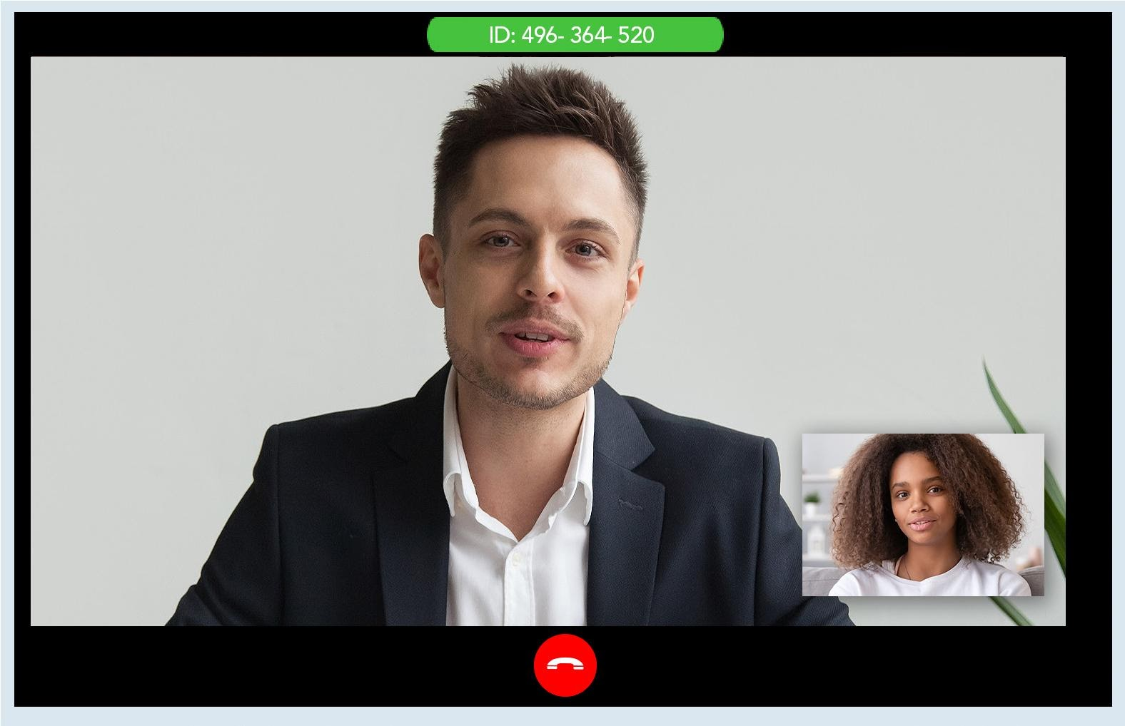
Use-Case Examples
Assessments-Psych Evals
Individual Treatment
Case Management
Supervision
Group Therapy
Psychoeducational Classes
Medication Management
Medication Assisted Treatment
Suicidal/Homicidal Ideation
Drug & Alcohol Abuse Cases
Setting Up Your School Telemental Health Program for Success © 2020 Jay Ostrowski, Behavioral Health Innovation

Slide 46

WHAT COULD GO WRONG?
Never connect - no video, no audio
Disconnection during session
Privacy problem - (Human)
Breach of privacy (Technical)
Client emergency or decompensation
Provider emergency
Illegal or unethical activities
Inability to fulfill the provider’s duty to warn/protect
Never get paid
Setting Up Your School Telemental Health Program for Success © 2020 Jay Ostrowski, Behavioral Health Innovation

Slide 47

HIGH LEVEL CLINIC REQUIREMENTS:
  Training and onboarding for Staff
  Onboarding clients/patients
  Ubiquitous accessibility
  HIPAA-FERPA Compliance (variances now and in the near future)
  Selecting software and technology
  Informed Consent
  Emergency Protocols
  Crossing State lines policies and procedures
  Easy workflows for staff and clients/patients
  Data flows - integration or not, Integration workarounds
  Measurement is essential for performance improvement.
Setting Up Your School Telemental Health Program for Success © 2020 Jay Ostrowski, Behavioral Health Innovation

Slide 48
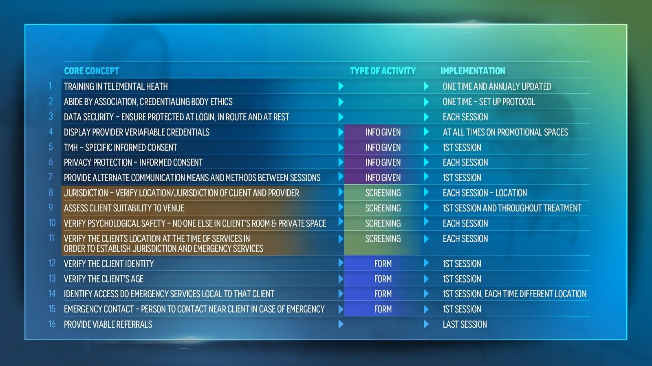
TELEMENTAL HEALTH BEST PRACTICES
Setting Up Your School Telemental Health Program for Success © 2020 Jay Ostrowski, Behavioral Health Innovation
Notes:
Once you find a client is suitable, the provide should review a consent form that is specific to TMH services. Your state and discipline may have specific requirements for what should be included in this consent. All clients who participate in online services should have an additional way to contact you outside of the internet. Should a communication failure occur, clients will need to use these back up communications to contact you. Again, all of these topics will be covered in more detail in the additional certification trainings.

Slide 49

TEMPORARY
COVID CHANGES
REGULATIONS
State License Regulations
Federal Emergency Waiver
State Governments
Restrictions Lifted
UNCHANGED
Ethical Requirements
Setting Up Your School Telemental Health Program for Success © 2020 Jay Ostrowski, Behavioral Health Innovation

Slide 50

  Getting Paid
    Many online services are reimbursable - Depending on the insurance
    And use of HIPAA-Secure software.
Video Assessments
Video Outpatient - Individual and Group
Video IOP
Secure Messaging
TeleMAT
Setting Up Your School Telemental Health Program for Success © 2020 Jay Ostrowski, Behavioral Health Innovation

Slide 51

Quick-Start Guide to Direct-To-Consumer Telehealth © 2020 JAY OSTROWSKI, BEHAVIORAL HEALTH INNOVATION
Setting Up Your School Telemental Health Program for Success © 2020 Jay Ostrowski, Behavioral Health Innovation

Slide 52










Needs For A Sustainable System?
Higher Volume -different Needs?
Measurements Needed?
Documentation?
Referral System?
PLAN BEYOND THE CRISIS
Setting Up Your School Telemental Health Program for Success © 2020 Jay Ostrowski, Behavioral Health Innovation

Slide 53
Consider new models of care and care habits - experiment with what may work now (pilot)?
Move beyond hourly work.
Rx apps and clinical workbooks
Peer support systems
Short-term clinical chat support
Use you EHR to the max
Automate
HIPAA will be enforced again, FERPA is still enforceable.
PLAN BEYOND THE CRISIS
Setting Up Your School Telemental Health Program for Success © 2020 Jay Ostrowski, Behavioral Health Innovation

Slide 54
  What are the greatest
  indicators of success?
Setting Up Your School Telemental Health Program for Success © 2020 Jay Ostrowski, Behavioral Health Innovation

Slide 55
WORKFLOWS
  Depends on type of service, staff and setting
Depends on need to integrate with existing workflows or technology.
CREATE PATIENT, PROVIDER AND STAFF WORKFLOWS FOR:
Registration, Suitability Screening, Tech Check, Identity Verification, Informed Consent, Scheduling, Document Sharing, Payment, Sending and receiving orders if not using the same electronic medical record.
Setting Up Your School Telemental Health Program for Success © 2020 Jay Ostrowski, Behavioral Health Innovation

Slide 56



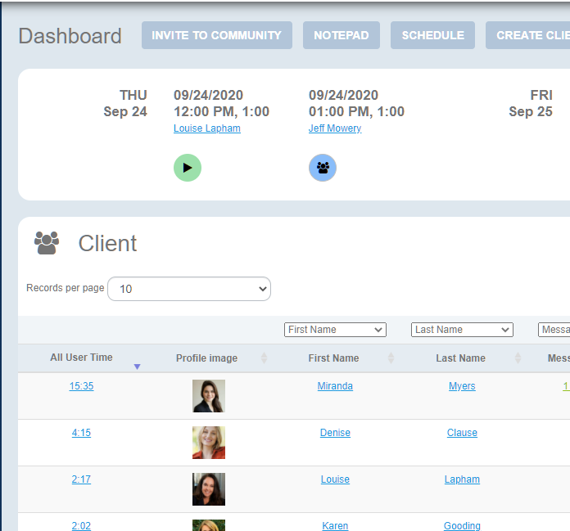
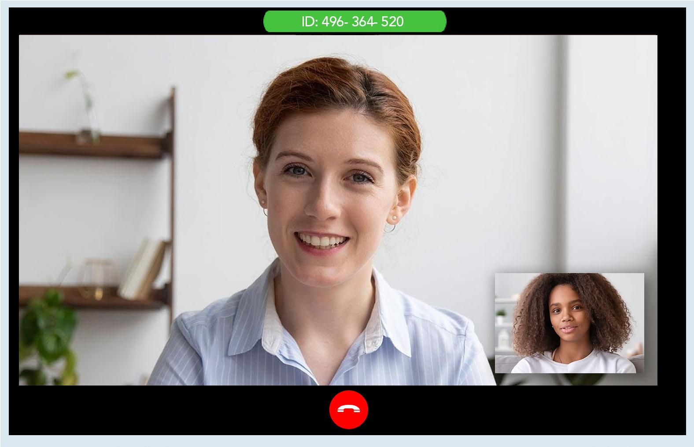
Automate Workflows
Simple, Automated, Video
HIPAA-compliant encrypted video meetings
Schedule video appointments from calendar
Instant meeting option available
Appointments automatically generate video links for all invited to the meeting
Link to the meeting is on calendars and dashboards
Calendar sync
SMS meeting reminders
Screen sharing and many additional user controls
Staff users can add or remove participants at any time without disrupting video links
Prompts to self-test microphone and video prior to meeting
Setting Up Your School Telemental Health Program for Success © 2020 Jay Ostrowski, Behavioral Health Innovation
Notes:
© 2020 AdaptiveTelehealth.com

Slide 57

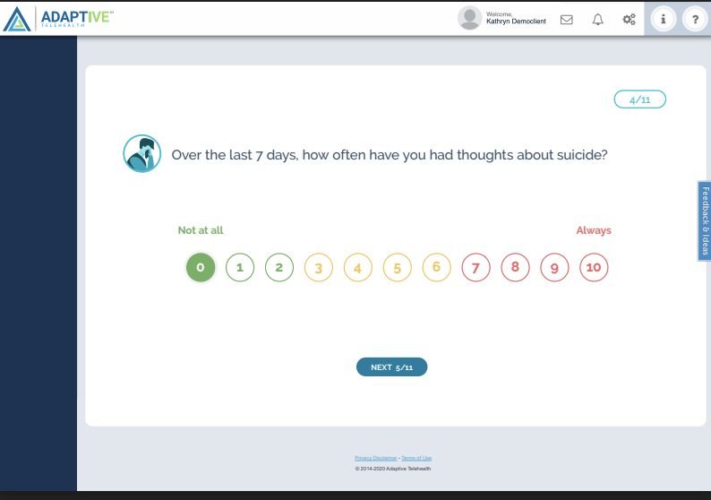
PATIENT ASSESSMENT APPS - Not typically in App Stores
WHAT’S POSSIBLE?
Any Assessment
Automated
Results Reported
Alerts
EXAMPLES:
Beck Depression
GAD 7
PHQ-9
MAST and more.
Setting Up Your School Telemental Health Program for Success © 2020 Jay Ostrowski, Behavioral Health Innovation

Slide 58





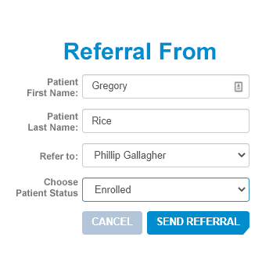


Secure Referral Processes
Provider will advise client to further individual counseling, fill out and participate in clinical workbooks, TeleMAT, community forum, and online IOP.
Setting Up Your School Telemental Health Program for Success © 2020 Jay Ostrowski, Behavioral Health Innovation

Slide 59
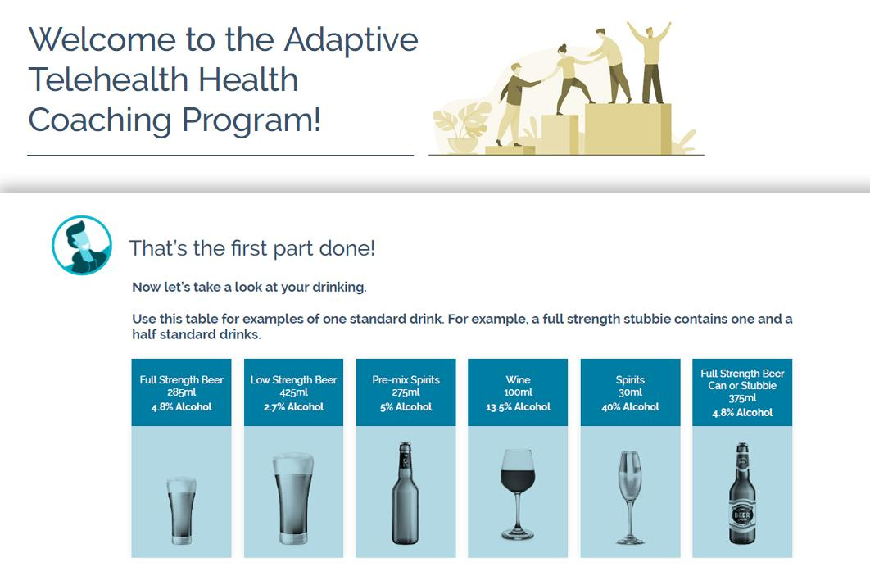

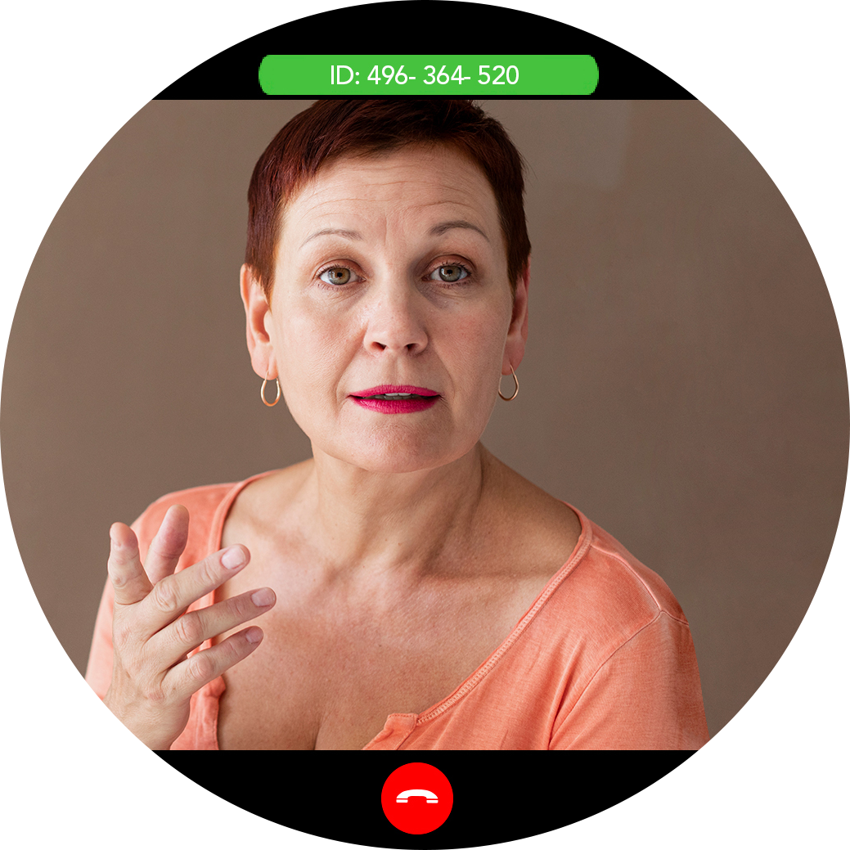
Asynchronous Programs
Welcome to the Program!
START PERSONAL SNAPSHOT
ASSESSMENT
Now, let’s take a look at your drinking
Client successfully registers to the portal and gets to see the welcome message with user guides. They can then fill out the assessments for drinking problems which they will also have an option to schedule appointment with providers via online video if preferred.
Client logs in to see a welcome message and fills in the assessment forms.
Setting Up Your School Telemental Health Program for Success © 2020 Jay Ostrowski, Behavioral Health Innovation

Slide 60

TBHCOE.MATRC.ORG
Setting Up Your School Telemental Health Program for Success © 2020 Jay Ostrowski, Behavioral Health Innovation

Slide 61
Webinar On Demand
Telebehavioral Health: A Quick Start Guide To Direct To Consumer Care During COVID-19
https://www.youtube.com/watch?v=oi7omAKbINk
Setting Up Your School Telemental Health Program for Success © 2020 Jay Ostrowski, Behavioral Health Innovation

Slide 62
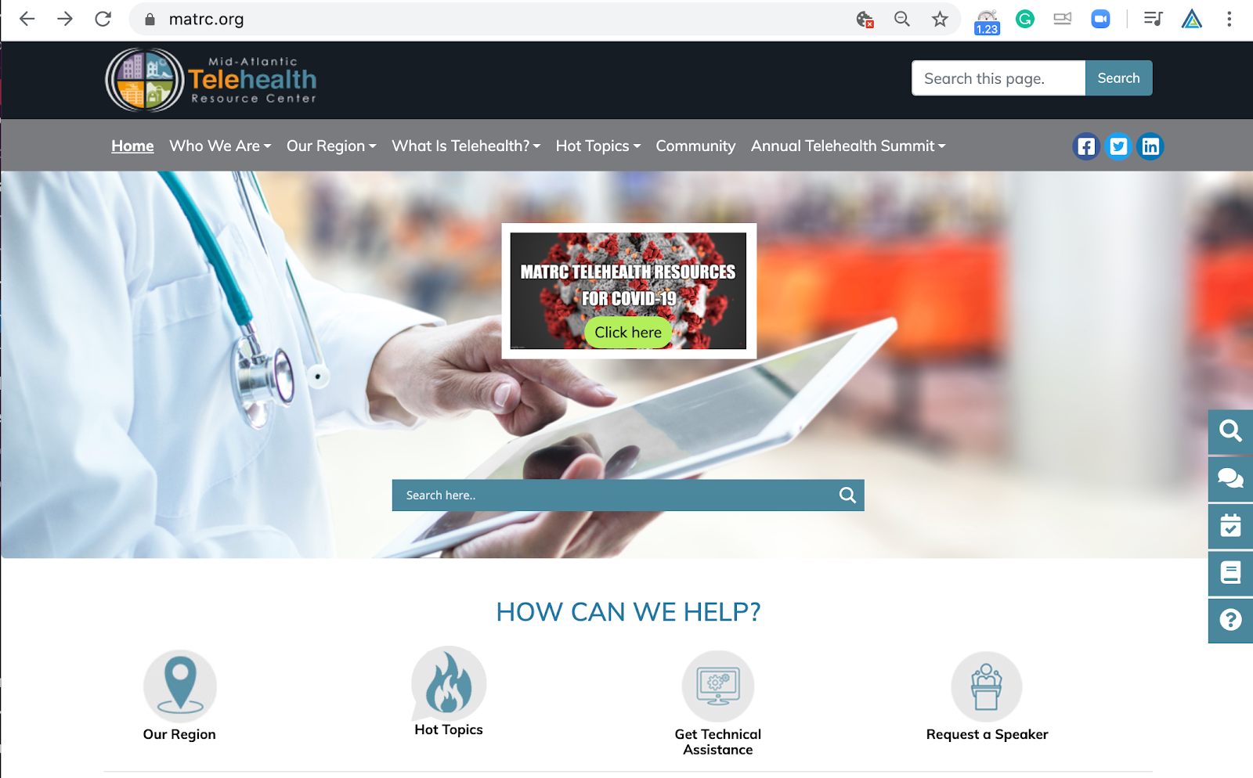
Setting Up Your School Telemental Health Program for Success © 2020 Jay Ostrowski, Behavioral Health Innovation

Slide 63



MATRC.org
SECOND HALF OF THE PAGE
OPEN OFFICE HOURS
Every Other Friday
12-2 EST
Setting Up Your School Telemental Health Program for Success © 2020 Jay Ostrowski, Behavioral Health Innovation

Slide 64
TELEMENTAL HEALTH RESEARCH REFERENCES
Same Efficacy
Same Methods
Same Services
Same Patients
Hilty, D. M., Parish, M. B., Chan, S., Torous, J., Xiong, G., & Yellowlees, P. M. (2020). A comparison of In-Person, Synchronous and Asynchronous Telepsychiatry: Skills/Competencies, Teamwork, and Administrative Workflow. Journal of Technology in Behavioral Science, 5(3), 273-288. doi:10.1007/s41347-020-00137-8
Tuerk, Peter W., Shore, Peter. Editors. Clinical Videoconferencing in Telehealth: Program Development and Practice. New York: Springer 2015. Page 15-16. 137
Luxton, D. D., O’Brien, K. McCann, R. A. and Mishkaind, M. C. 2014. Home-based telemental healthcare safety planning: What you need to know, Telemedicine and e-Health
Novella, J. K., Ng, K., & Samuolis, J. (2020). A comparison of online and in-person counseling outcomes using solution-focused brief therapy for college students with anxiety. Journal of American College Health, 1-8. doi:10.1080/07448481.2020.1786101
Douglas, S., Jensen-Doss, A., Ordorica, C., & Comer, J. S. (2020). Strategies to enhance communication with telemental health measurement-based care (tMBC). Practice Innovations, 5(2), 143-149. http://dx.doi.org/10.1037/pri0000119
Halphen, J., Dyer, C., Lee, J., Reyes-Ortiz, C., Murdock, C., Hiner, J., & Burnett, J. (2020). Capacity evaluations for adult protective services: Videoconference or in-person interviews. Journal of Elder Abuse and Neglect, 32(2), 121-133. doi:https://doi.org/10.1080/08946566.2020.1740127
Hilty, D. M., Parish, M. B., Chan, S., Torous, J., Xiong, G., & Yellowlees, P. M. (2020). A comparison of In-Person, Synchronous and Asynchronous Telepsychiatry: Skills/Competencies, Teamwork, and Administrative Workflow. Journal of Technology in Behavioral Science, 5(3), 273-288. doi:10.1007/s41347-020-00137-8
Morland, L. A., Mackintosh, M., Glassman, L. H., Wells, S. Y., Thorp, S. R., Rauch, S. A., . . .Acierno, R. (2019). Home‐based delivery of variable length prolonged exposure therapy: A comparison of clinical efficacy between service modalities. Depression and Anxiety, 37(4), 346-355. doi:10.1002/da.22979
Myers, U. S., Coulon, S., Knies, K., Dickens, K., Keller, S. M., Birks, A., & Grubaugh, A. L. (2020). Lessons Learned in Implementing VA Video Connect for Evidence-Based Psychotherapies for Anxiety and Depression in the Veterans Healthcare Administration. Journal of Technology in Behavioral Science. doi:10.1007/s41347-020-00161-8
Novella, J. K., Ng, K., & Samuolis, J. (2020). A comparison of online and in-person counseling outcomes using solution-focused brief therapy for college students with anxiety. Journal of American College Health, 1-8. doi:10.1080/07448481.2020.1786101
Patel, S. Y., Huskamp, H. A., Busch, A. B., & Mehrotra, A. (2020). Telemental Health and US Rural–Urban Differences in Specialty Mental Health Use, 2010–2017. American Journal of Public Health, 110(9), 1308-1314. doi:10.2105/ajph.2020.305657
Rojas, S. M., Piccirillo, M. L., McCann, R. A., Reger, M. A., & Felker, B. (2020). An examination of suicidal behaviour among veterans receiving mental-health appointments in person versus clinical video telehealth. Journal of Telemedicine and Telecare. https://doi.org/10.1177/1357633X20942041
Setting Up Your School Telemental Health Program for Success © 2020 Jay Ostrowski, Behavioral Health Innovation

Slide 65

Key Questions to Ask when searching for a Telehealth Specialty Service Provider
    Kathy J. Chorba
    Executive Director
    California Telehealth Resource Center
    chorbak@ochin.org

Slide 66
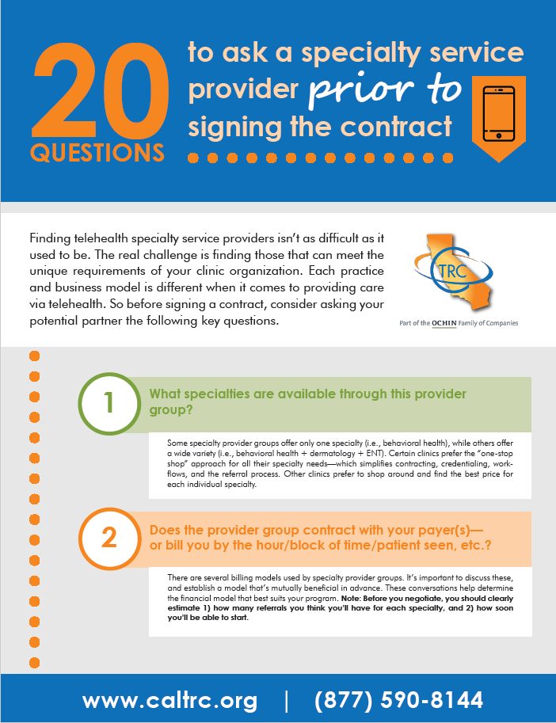
Why Create This Resource?
Finding telehealth specialty service providers is not as difficult as it has been in the past.
The challenge is to find specialty service providers that will meet the unique needs and requirements of your clinic organization.
Before contracting with any specialty service provider group, we invite clinics to consider adding the questions listed in this presentation to their existing process for vetting potential partners.

Slide 67
Question Categories
Getting to Know the Specialty Provider Group
Defining Expectations
Setting Communication Terms
Support Considerations

Slide 68
Getting to Know the Specialty Provider Group
Specialty provider groups will have different policies, procedures, credentialing preferences and billing models – all of which are important to understand before making a final contracting decision.

Slide 69
Specialty Options
Ask:
“What specialties are available through this provider group?”
Notes:
Some specialty provider groups offer one specialty only (such as Behavioral Health) and others offer a wide variety of specialties (including Behavioral Health).
Some clinics prefer the “one stop shop” for all their specialty needs, which would simplify the contracting, credentialing, referral process and workflow, and other clinics prefer to shop around and find the best price and/or service for each specialty.

Slide 70
Credentialing Policy
Ask:
“Does the specialty group have a credentialing policy or preference?”
Notes:
By proxy or full credentialing will make a difference in how fast you can bring a specialist on-board and should be established in advance.
If you are billing on behalf of the specialty provider, you will need to bring them into your four walls and will need to credential them at your site.
Some specialty providers will only utilize credentialing by proxy, while others will accept your wishes for full credentialing.
In addition, you’re going to need to keep in mind the specialty providers will need to be credentialed with the patient’s health plan in order to be able to bill for the service.

Slide 71
Referral Process
Ask:
“Does the specialty provider group have referral guidelines for each specialty?”
Notes:
Referral guidelines are an important communication tool that specify the time required for new and follow-up patients, as well as if/when a provider should be in the room during the consult, and finally, the information that is needed prior to the consult (labs, chart notes, etc.).
This will be helpful so that you know the exact requirements as they may vary from specialist and specialty.

Slide 72
Billing Models
Ask:
“Does the specialist or provider group contract with your payer(s), bill you by the hour or blocks of time scheduled, by the number of patients seen, or some other scenario? ”
Notes:
There are several billing models used by specialists and specialty provider groups, and it’s important to discuss these and establish a model that‘s mutually beneficial in advance. This will help you to determine the financial model that best fits your program.
One thing to keep in mind: Before you negotiate, you should know how many referrals you think you will have for each specialty and how soon you will be able start.

Slide 73
Price Rate
Ask:
“What are the specialty service provider’s rates for live video and store and forward? Are they the same for adult and pediatric specialties?”
Notes:
Depending on the specialty services needed, as well as volume and modality for each specialty, rates will vary.
Rates for store and forward specialties will typically be lower than live video specialties, and new patient appointments may be more expensive than follow-up appointments.
Also, rates may vary according to the volume of patient referrals you anticipate sending to the specialty group.
Keep in mind if a specialty group bills by the hour, it is important to know the time required for new and follow-up patients
If the specialty group bills by the completed encounter, the rates may be higher than the hourly rate.

Slide 74
Defining Expectations
Just like hiring any new staff member, it is critical to ensure the right specialist is chosen for your organization. It’s important to know what your expectations of the specialists are, and what the specialist’s expectations are of you. The following questions may help you clarify these roles.

Slide 75
Presenting Staff
Ask:
“Does the specialist expect an MA, RN, NP, PA, or MD in the room with the patient during the encounter, and for how much time?”
Notes:
Some specialists will have a preference and may not be willing to let you determine who presents the patient. Some specialties, like Behavioral Health, don’t require a provider in the room during the consult. Agree in advance how much time they will require staff to be in the room.
This is important to know for staffing, scheduling, billing and budgeting purposes.
For example, if an FQHC site is billing on behalf of the specialist, the FQHC can only submit one bill per patient per day (not one bill for the PCP and another for the specialist). In this case, the specialty service provider that doesn’t require a PCP to be present during the consult would be economically preferable.

Slide 76
Appointment Time
Ask:
“What is the expected timeframe that specialists will require for new and follow-up patients?”
Notes:
Timeframes vary for each specialty and also the specialist providing the service. Most specialists require 40 minutes with new patients and 20 minutes for follow-up patients.
This is crucial to know when the billing model is to pay by the hour as you will need to structure your appointment schedule strategy to ensure you can financially afford the specialist’s time.

Slide 77
Question
When paying a specialty service provider by the hour …
When is the $250/hour specialist less expensive than the $200/hour specialist?

Slide 78
Answer
When the $250/hour specialist can
fit more patient visits into each hour

Slide 79
This is a very basic, yet illuminating tool
What this will do
Provide a high level, VERY BASIC overview of how specialty provider selection decisions and other variables are likely to affect sustainability
What this will not do
Calculate for:
  sliding fee or commercial health plan payments
  Appointment slots filled by double booking
Provide an accurate, detailed profit/loss statement for clinic financial modeling
NOTE: Clinic collection revenue on this form is based on PPS Medicaid patient billable visits only. Other payment sources cannot be predicted or calculated using this simple tool.

Slide 80
Onboarding Process
Ask:
“What is the onboarding process
for new clinics?”
Notes:
Specialty service provider groups may provide :
training on patient presentation techniques,
training on the referral process,
training on equipment usage, and
video meet and greet sessions with the specialists and referring providers.
Some or all of these may be of no cost to you, while others may come with a small charge.

Slide 81
Continuity of Care
Ask:
“Will you be able to utilize the same specialist that has already seen the patient, or does it just depend on availability?”
Notes:
Maintaining your relationship with the same specialist helps you feel confident of what to expect and also assures continuity of care as it pertains to diagnosis and medication prescribing.
And, Having the patient be comfortable and have formed a relationship with the same specialist, is crucial for trust and compliance with treatment recommendations.

Slide 82
No-Show Policy
Ask:
“What is the policy on patient no-shows
or cancellations?”
Notes:
Each specialist may have a different policy and it’s important to know upfront if you are able to cancel or reschedule patients, and what the financial responsibility is.
For example, if you are paying the specialist by the completed encounter, their tolerance for no-show patients will be lower than if you are paying them by the hour reserved.

Slide 83
Overbooking Patients
Ask:
“Is the referring site allowed or expected
to overbook patients?”
Notes:
Knowing there are often no-shows with patient appointments, most specialists will allow and/or expect you to overbook patients.
It’s important to establish what you mutually agree will work and will not disrupt the practice and the Telehealth clinic.

Slide 84
Direct Patient Care vs. Consultation Only
Ask:
Does the specialist provide
“direct patient care” or offer
“consultation only”?
Notes:
Direct patient care implies the specialty provider will make a diagnosis and treatment plan and will prescribe medication independent from the primary care provider.
With the consultation only model, the specialist will send treatment recommendations to the primary care provider, who will be responsible for prescribing medication.
This would be important to know since you want to discuss this with your providers to see if they feel comfortable prescribing for a patient after only reviewing the specialist’s notes and recommendations.

Slide 85
Medication Refills
Ask:
“How will medication refills be handled?”
Notes:
It’s important to discuss who will be responsible and how will prior authorizations be handled.
For example, if the provider operates in your EHR and is using e-script, you will want someone to handle these refill requests and prior authorizations just as you would for any of your providers in-person.

Slide 86

Specialist Credentials
Ask:
“Will the specialist or specialty group provide a bio of the specialist?”
Notes:
It’s very reassuring to you and your patients to see the level of education, training, and the affiliations/board certification of the specialist.

Slide 87
Setting Communication Terms
Proper communication between the staff and the specialist is necessary for a smooth flowing clinic.

Slide 88
Open Communication Between Providers
Ask:
“Can the referring site provider call or videoconference the specialist before or after the consult?”
Notes:
Sometimes there may be a need to speak to the specialist without the patient present.
You should ask if that’s acceptable and if there is a cost associated.

Slide 89
Chart Turnaround Timeline and Process
Ask:
“What is the turnaround time on charts being returned, and how will they be sent?”
Notes:
You should set an expectation upfront with the specialist and hold them accountable to timely completion and transmission of all consult notes after the completed visit.
This is not only important for the maintenance of provider to provider communication for continuity of patient care, but for billing purposes as well.
Some specialty service providers require the originating site to access their EHR to pull down chart notes for each patient (more work for the originating site) and others will agree to document directly into your EHR (more work for the specialty site).

Slide 90
Staff Communication
Ask:
“How will staff communicate with the specialists during the visits, if they are not present in the room with the patient?”
Notes:
You will need to address what type of communication (text, email, and phone) is expected when either the staff has a question, or if the specialist needs the staff to step in the room at any time during the consult.
This information is useful in order to provide the coordinator the proper tools for a smooth flowing clinic.
Oftentimes clinic coordinators are not issued cell phones, or the room where the telemedicine equipment is located isn’t near a station that’s equipped with a desk phone or computer.

Slide 91
Acceptable Correspondence
Ask:
“What type of correspondence is acceptable between the referring site and the specialist?”
Notes:
Discuss if calls, emails, text messages, or flags in patient’s charts are acceptable.
And can these items be communicated directly from provider to provider, or only through a third party (such as a scheduler, coordinator, or receptionist)?

Slide 92
Support Considerations
While most health care organizations have some level of technical support staff available, some do not have staff that are able to troubleshoot telemedicine video, peripheral equipment, and/or broadband connectivity. All specialty service provider groups should have a policy for technology failure.

Slide 93
Technical Support
Ask:
“What level of technical support will the specialty provider group provide?”
Notes:
While most primary care clinic sites have some level of technical support staff available, very few clinics have staff that are able to troubleshoot telemedicine video and peripheral equipment and/or broadband connectivity for video transmission.
Some specialty provider groups provide a basic level of technical support or troubleshooting assistance in order to make sure services are provided as scheduled.

Slide 94
Backup Plan for Equipment Failure
Ask:
“What is the emergency backup policy or plan for technology failures?”
Notes:
This is an important question to ask.
What is the procedure that the specialty service provider follows should the video conferencing software disconnect during a session?
How many attempts to reconnect should you make?
Should you call the specialty service providers office? Will they contact your coordinator?
What is the process for finishing the appointment or rescheduling the patient should you not be able to reconnect?
All specialty service provider groups should have a policy for technology failure.

Slide 95
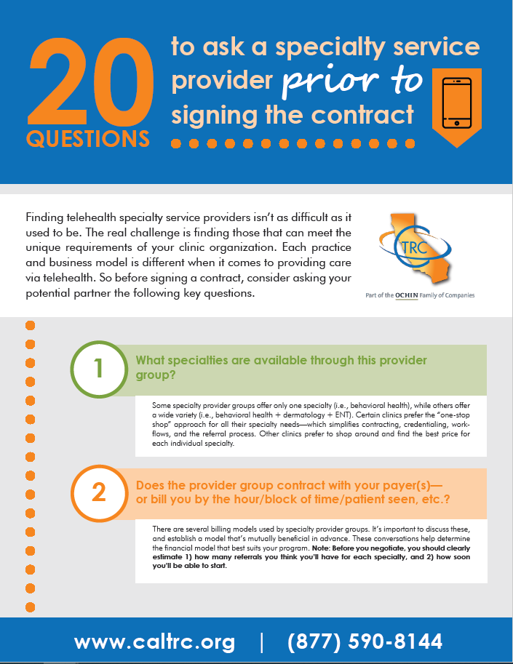
To download the
20 Questions document, please visit the Resources page at CalTRC.org

Slide 96



We’re here for you!
Let’s Talk!

Slide 97
Next and Upcoming Sessions
January Sessions
Pandemic Response - Best Practices & Lessons Learned
January 13th, 2021: 11 AM – 12 PM PT
January 27th, 2021: 11 AM – 12 PM PT

Slide 98

Thank you!

